Slide 1
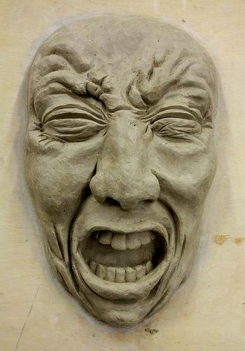
Facial Expression
How to sculpt dramatic facial expressions in clay!

Slide 2
Objective
You are going to sculpt an expressive face.
You will learn:
  How to mold clay into a form
  Create individual facial features
  Create 3D/sculptural/realistic faces in clay
We will sculpt each piece separately and one at a time

Slide 3
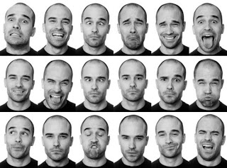
Choosing your expression
We sculpt unique expressions.
We go beyond happy, sad, mad to more detailed & realistic human expressions

Slide 4
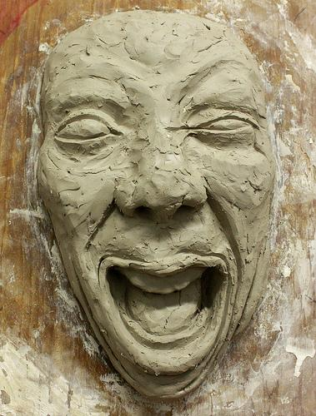
We do basic sculpting by ADDING & SUBTRACTING clay
-We will build the majority of all features first.
    -Getting all features onto the face
-Build up areas that stick out
-What areas of the face stick out the most?

Slide 5
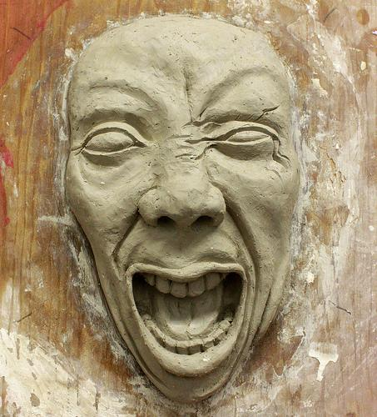
After we ADD clay we SUBTRACT to emphasize details
-After we add on all our features, we then carve to create artistic details and originality.
-Carve away areas that have shadows (mouth)
-What areas of the face sink in the deepest?

Slide 6
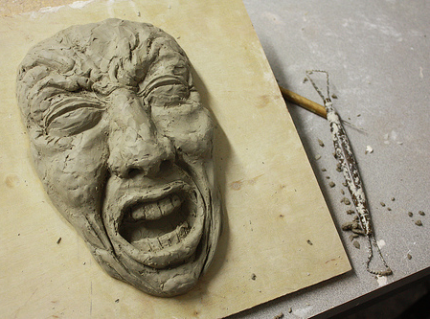
Express Yourself!
-Exaggerate the expression by accentuating certain features of the face. Pick one or two features not everything!
-How can you make it your own? Add other elements to make it unique like hair or other decoration

Slide 7
DETAILS! DETAILS! DETAILS!
To refine your work, add more details!
-Define small wrinkles and shapes by the ‘add some, carve some’ technique

Slide 8
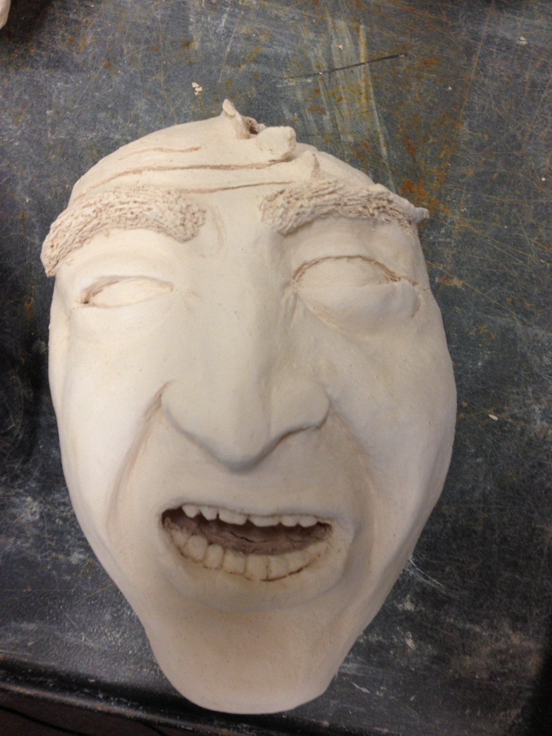
Student Examples

Slide 9
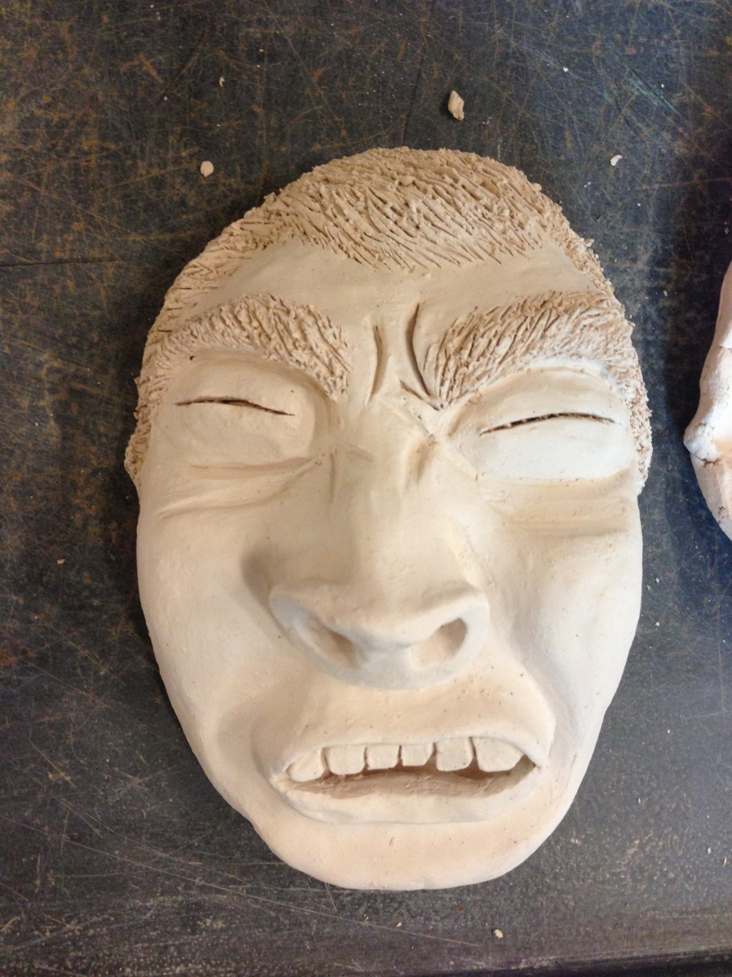
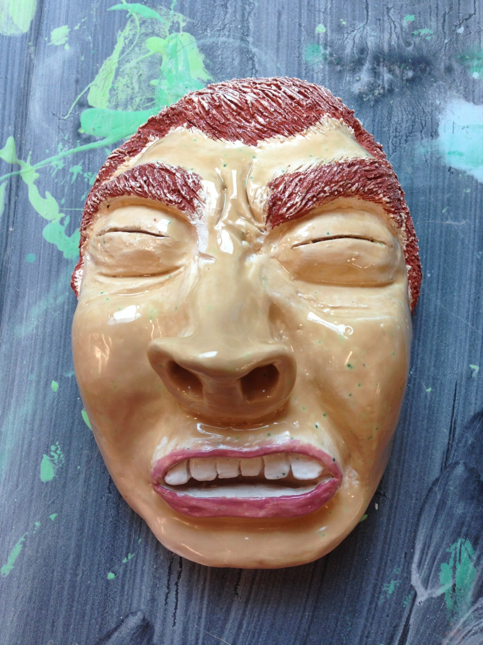

Slide 10
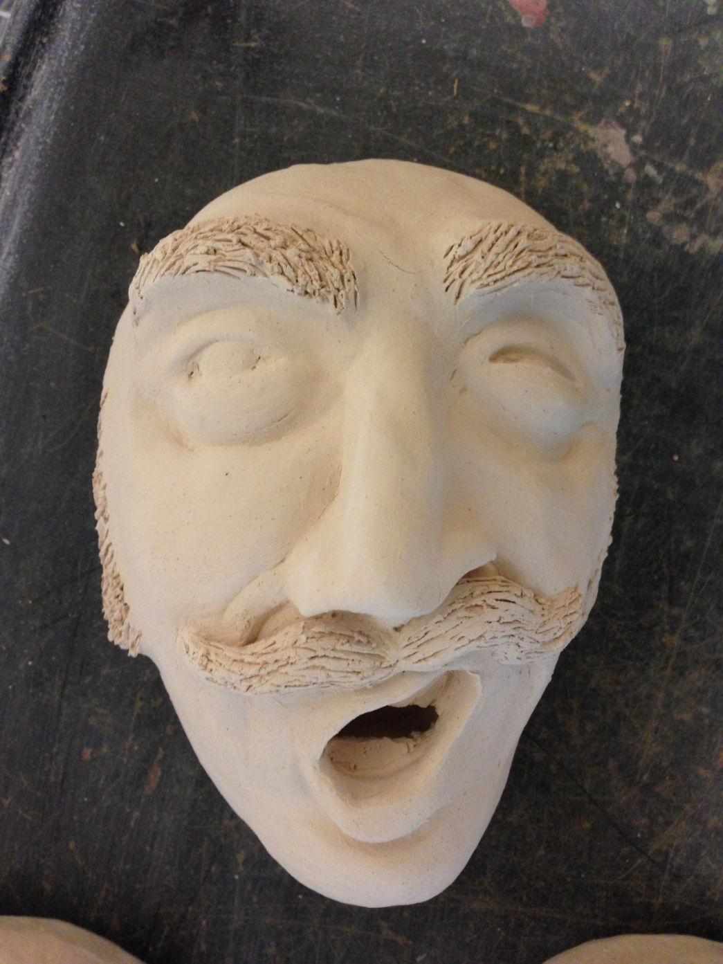
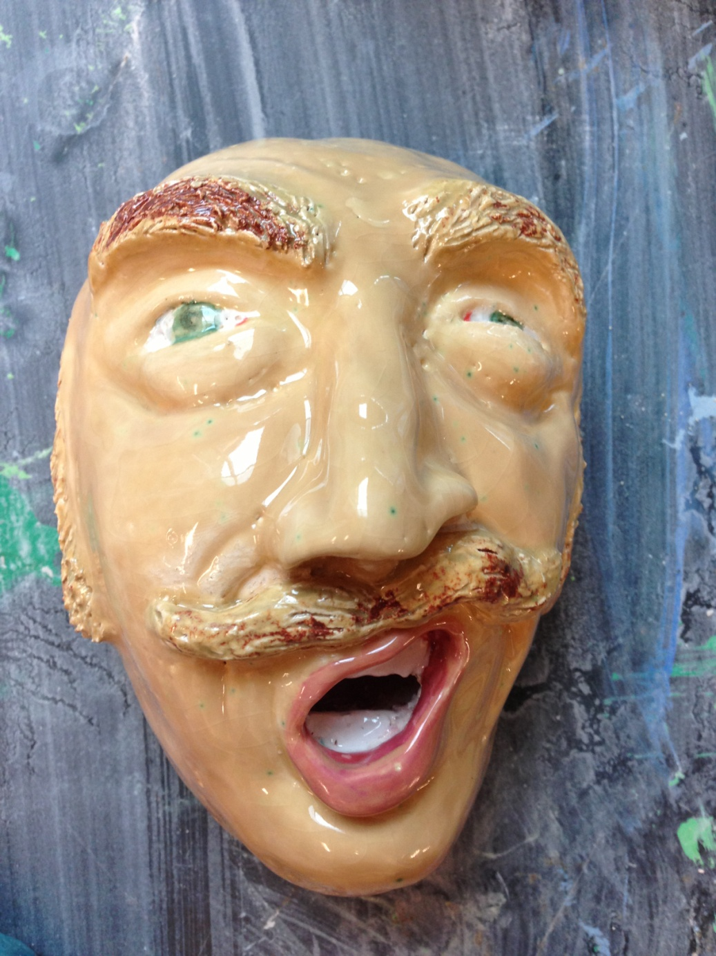

Slide 11
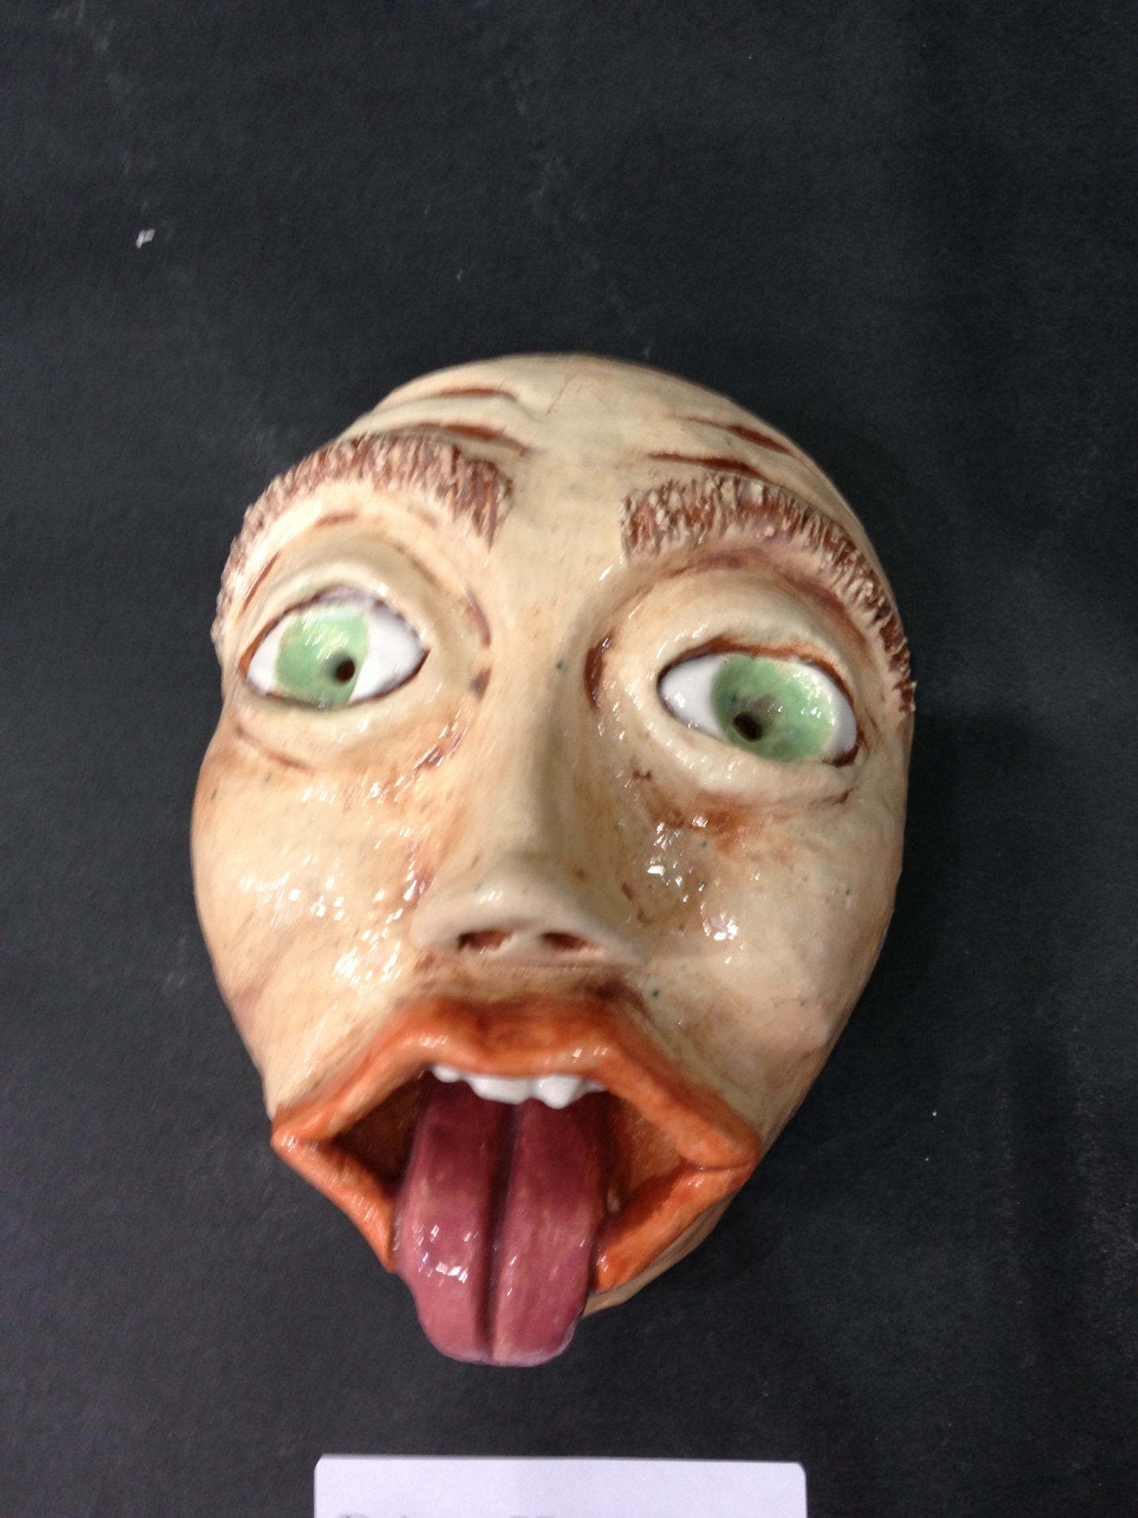
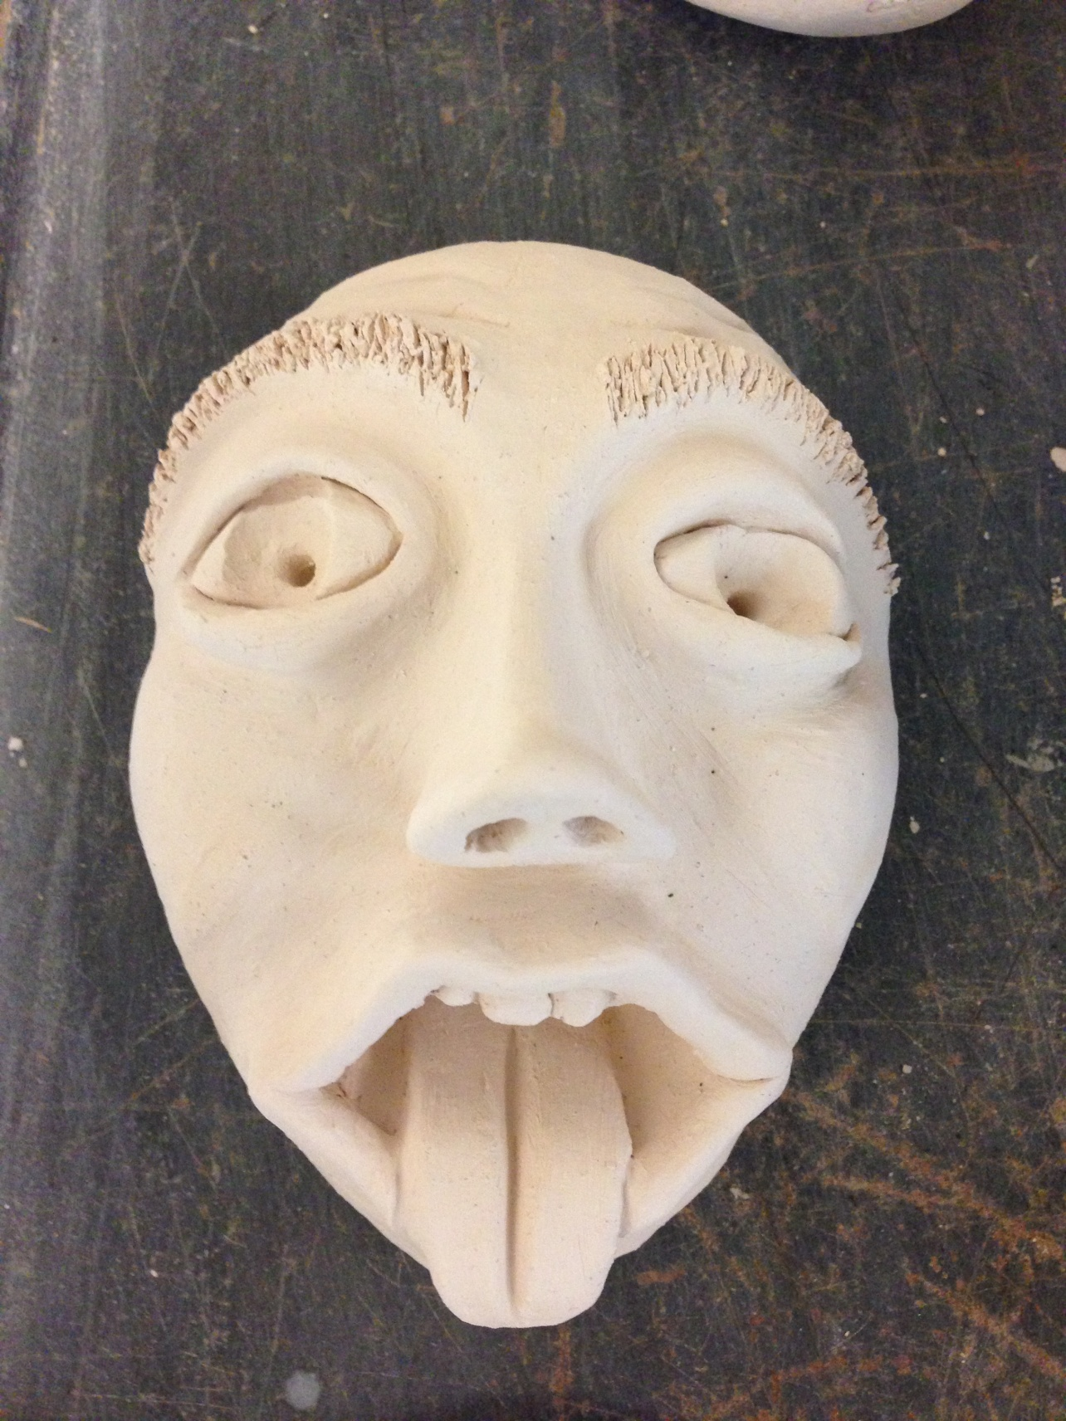

Slide 12
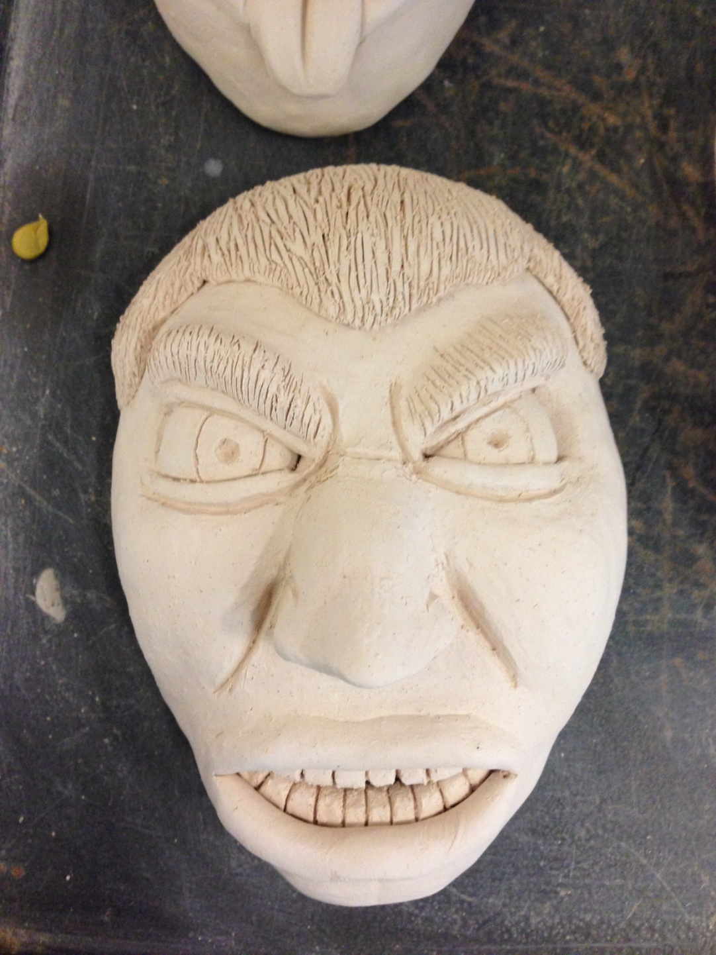
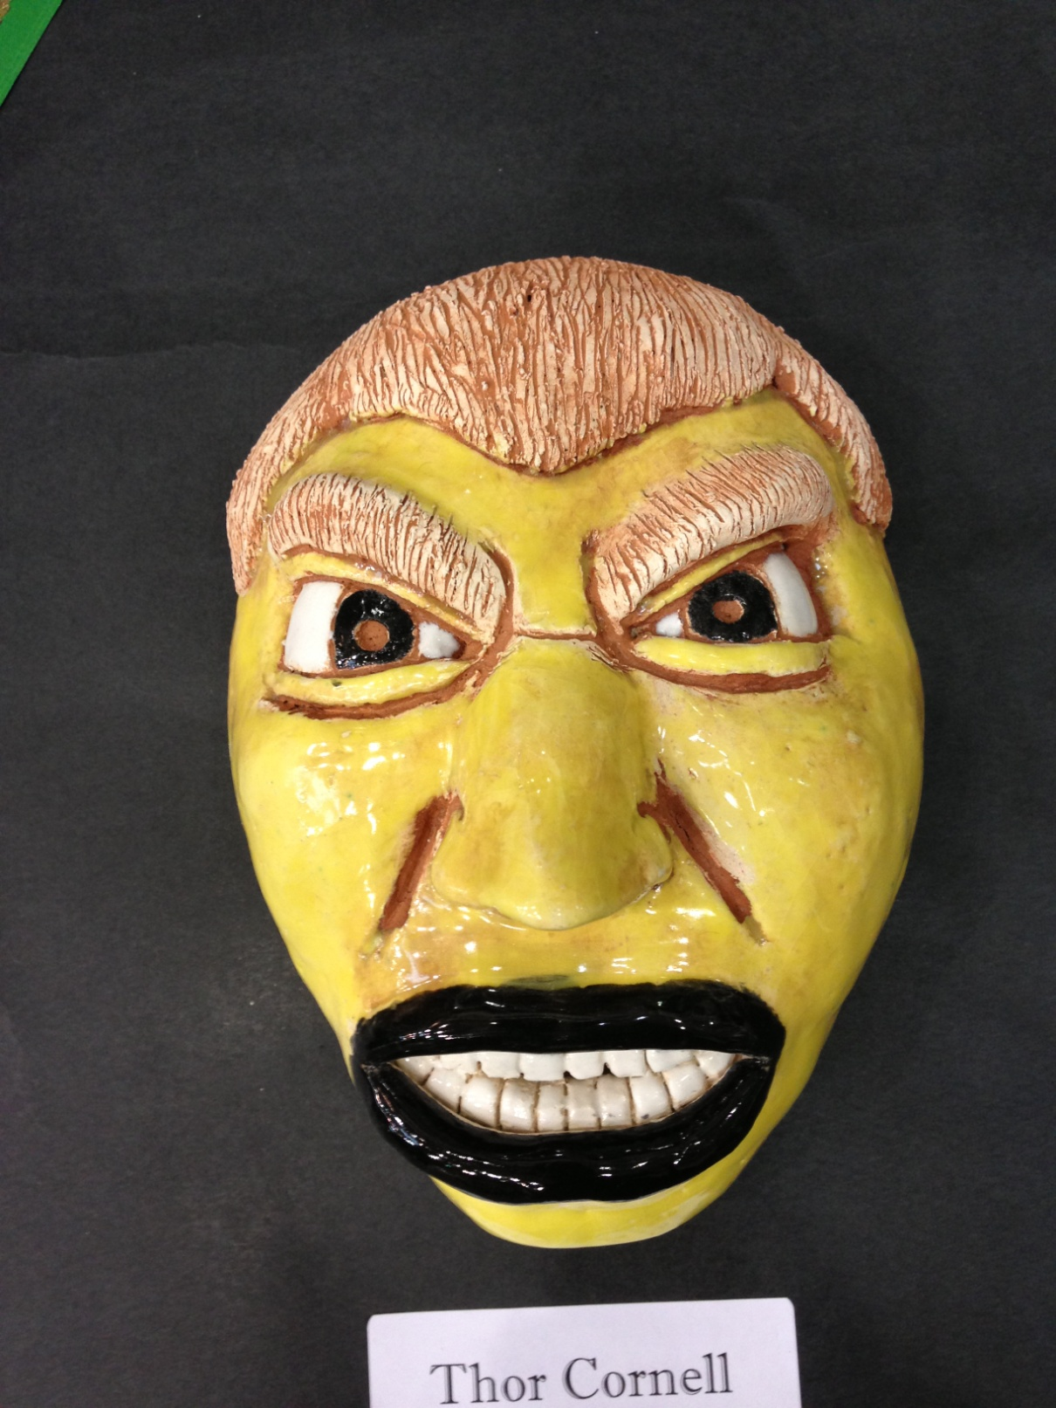

Slide 13
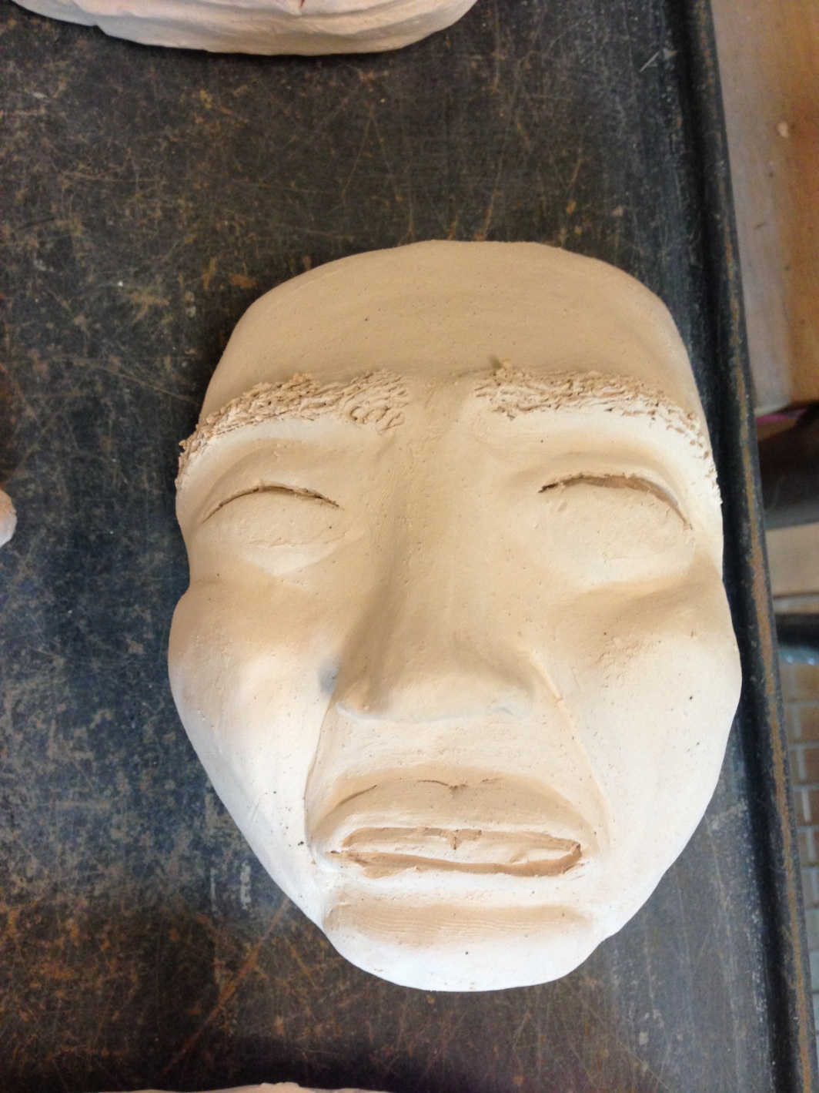
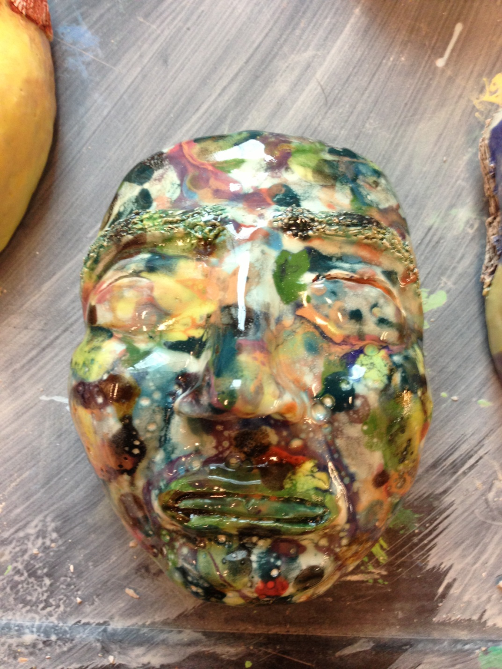

Slide 14
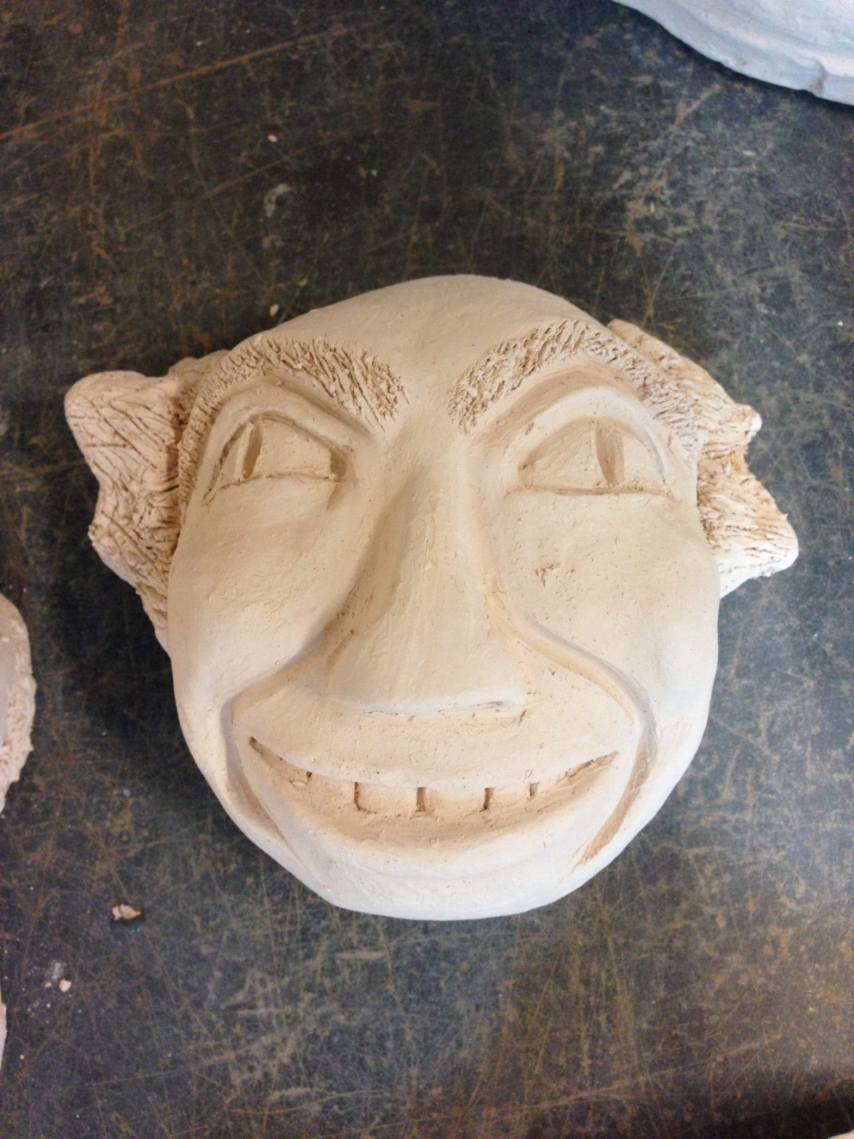
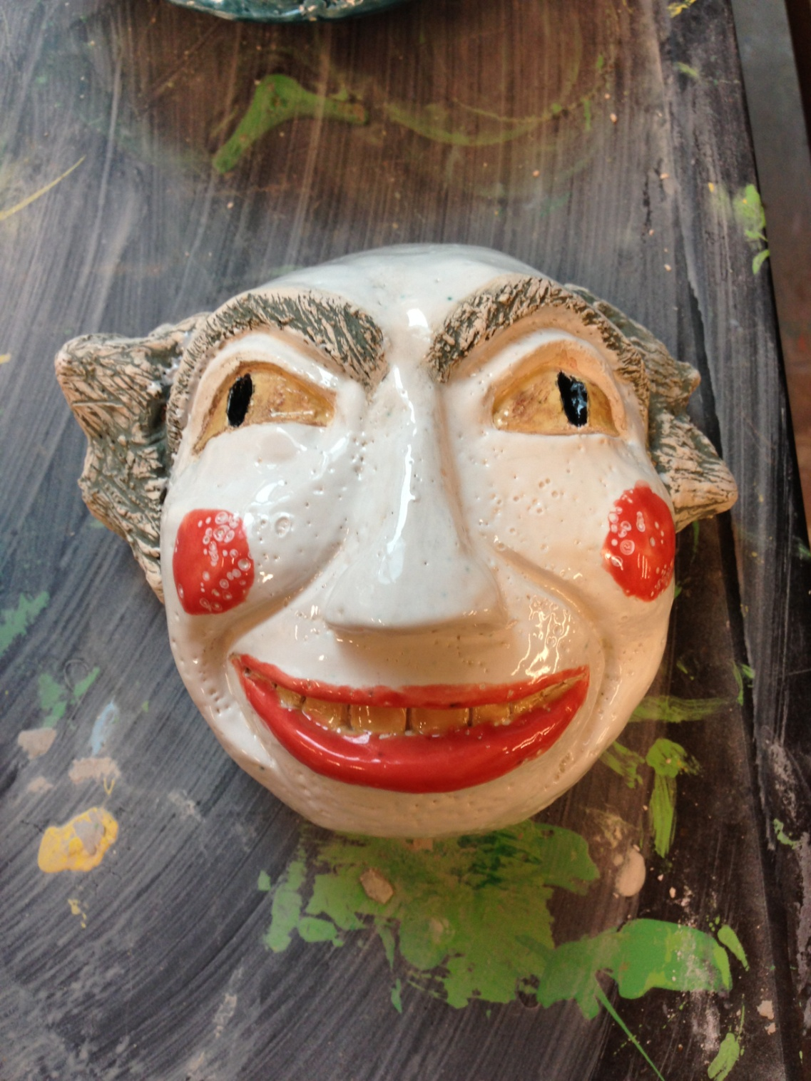

Slide 15
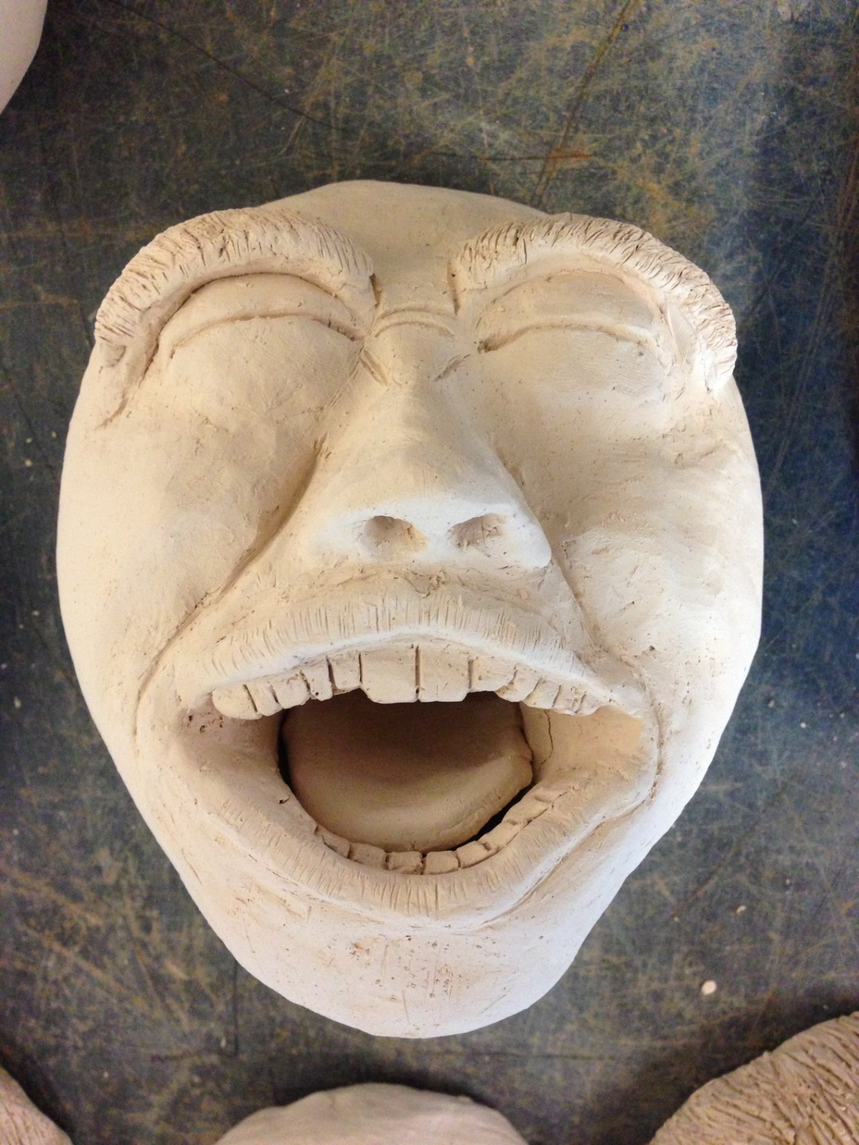
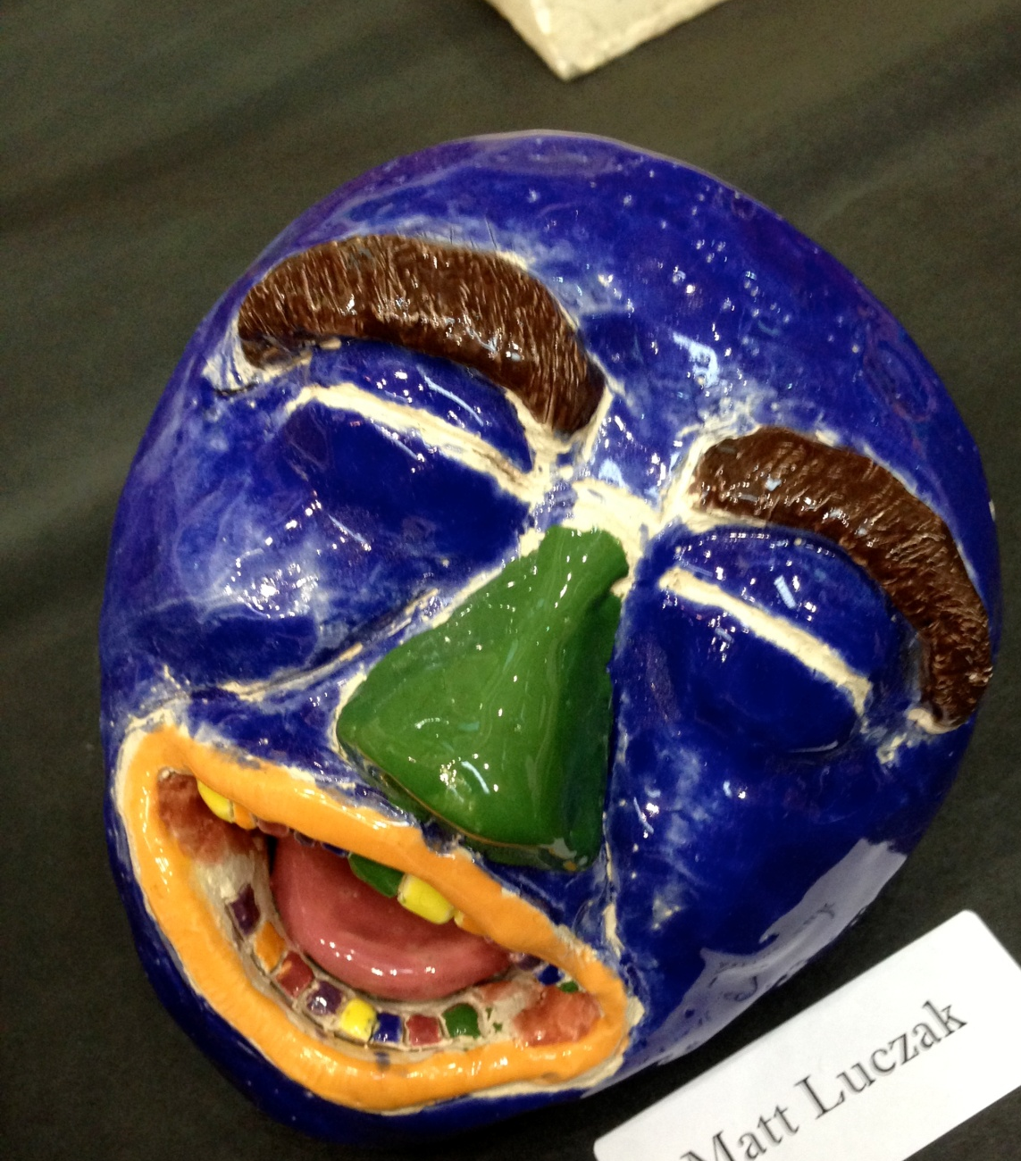

Slide 16
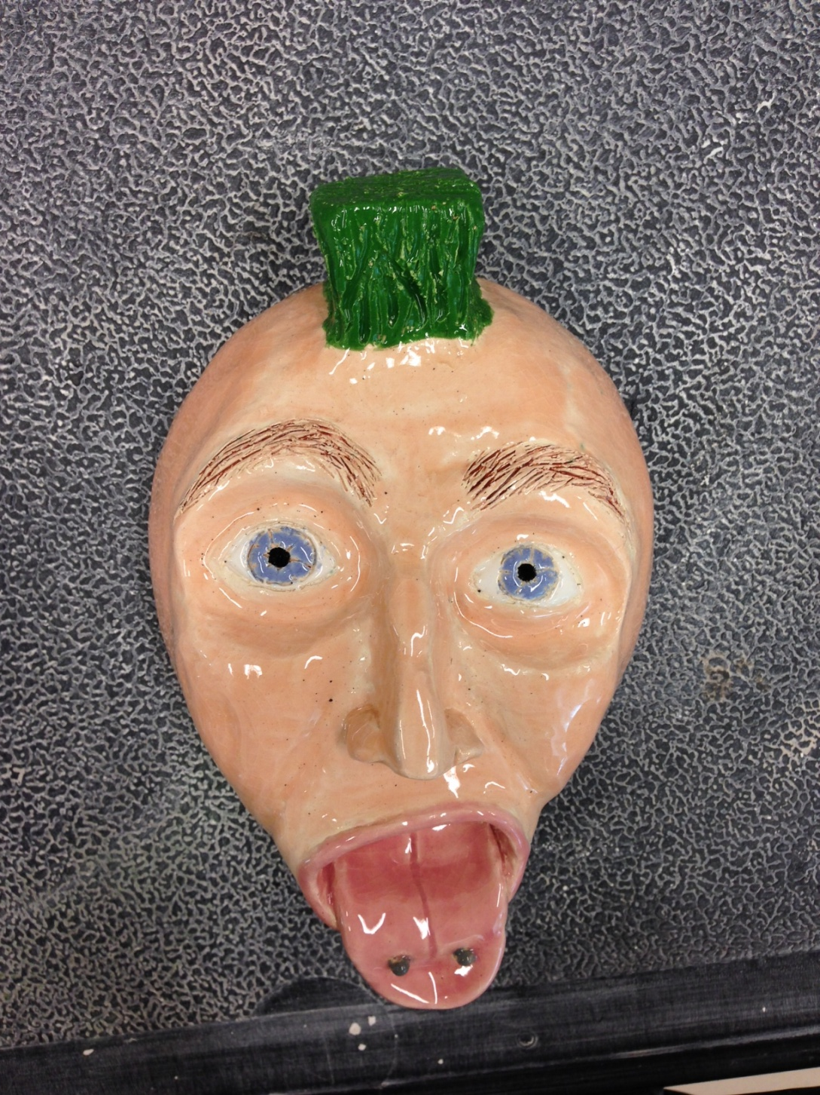
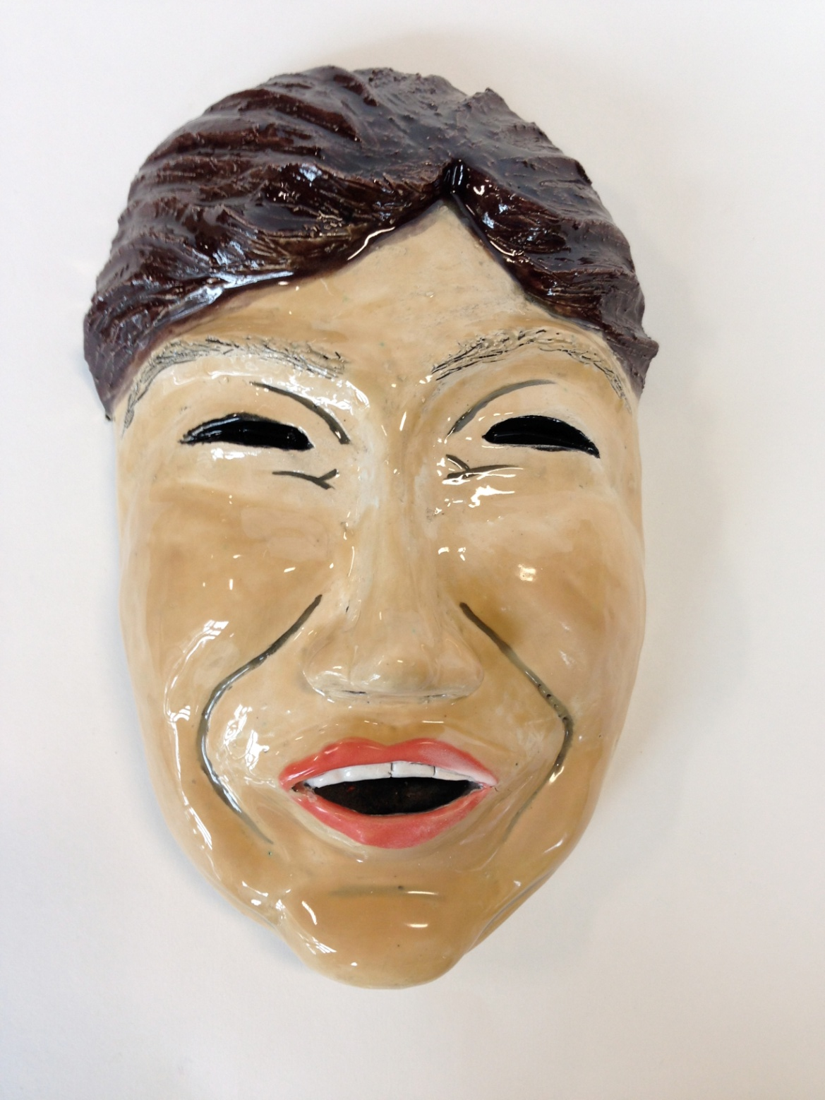

Slide 17
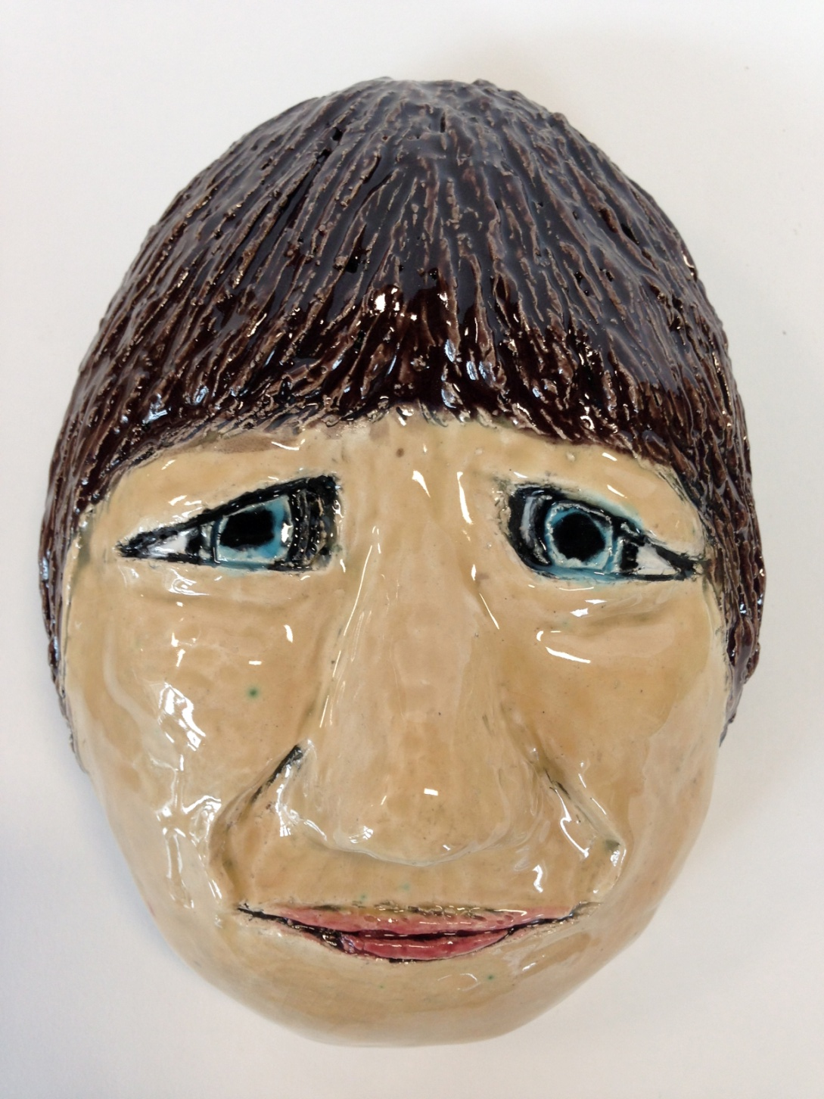
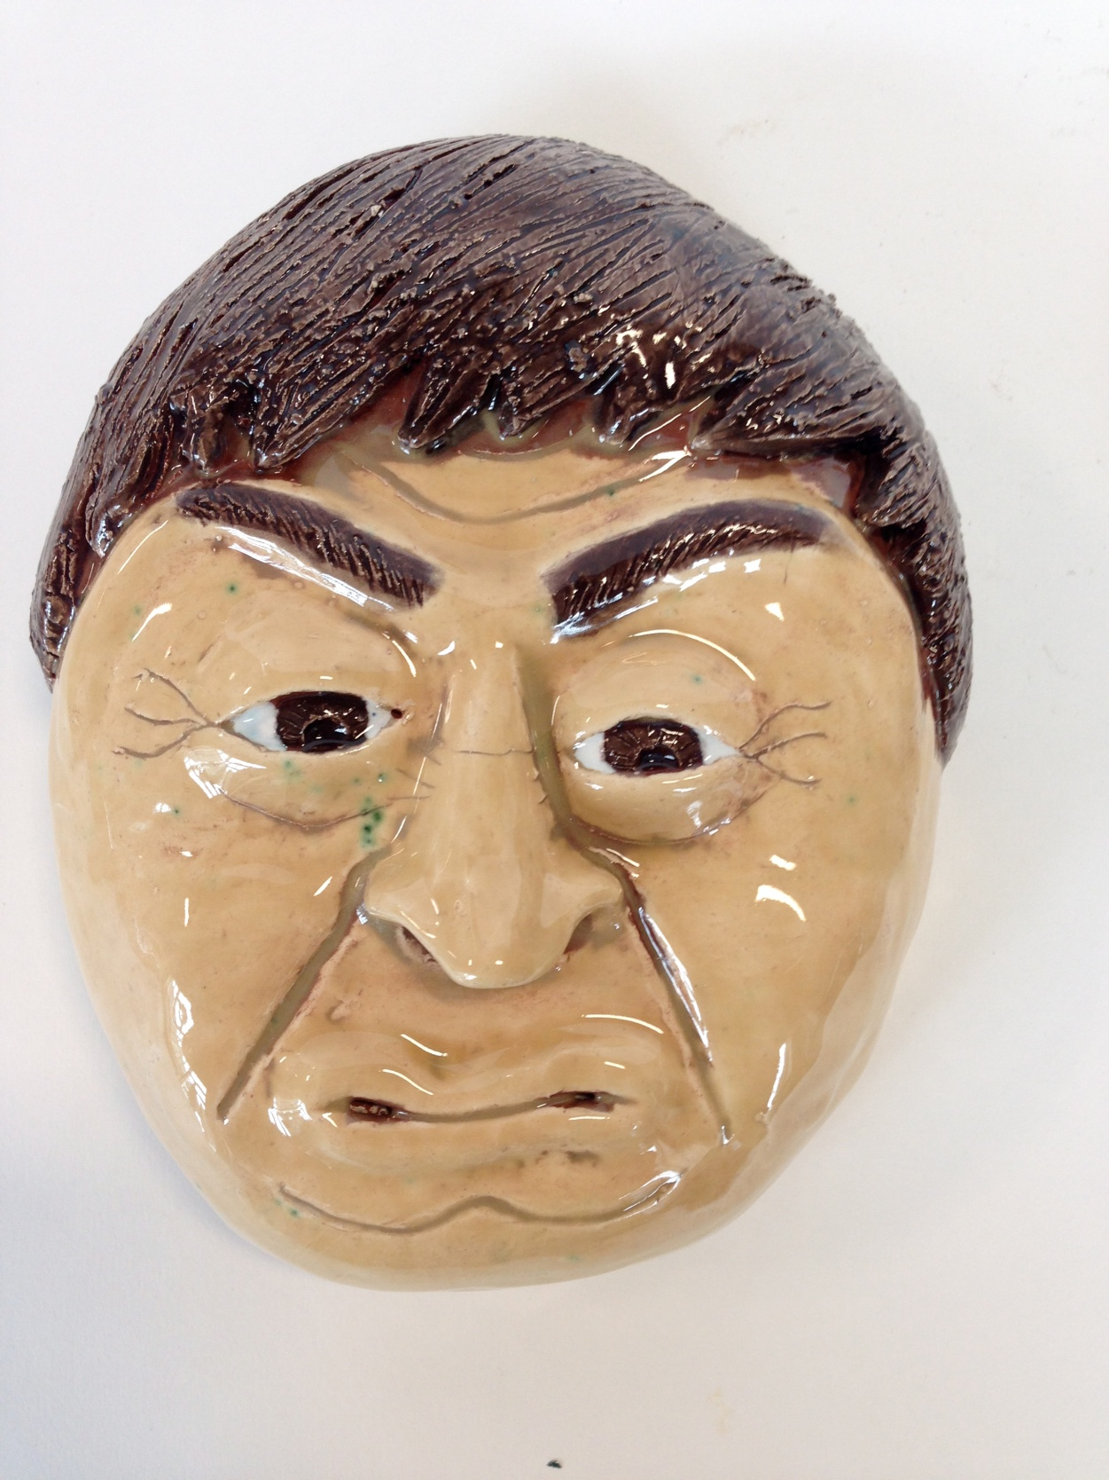

Slide 18
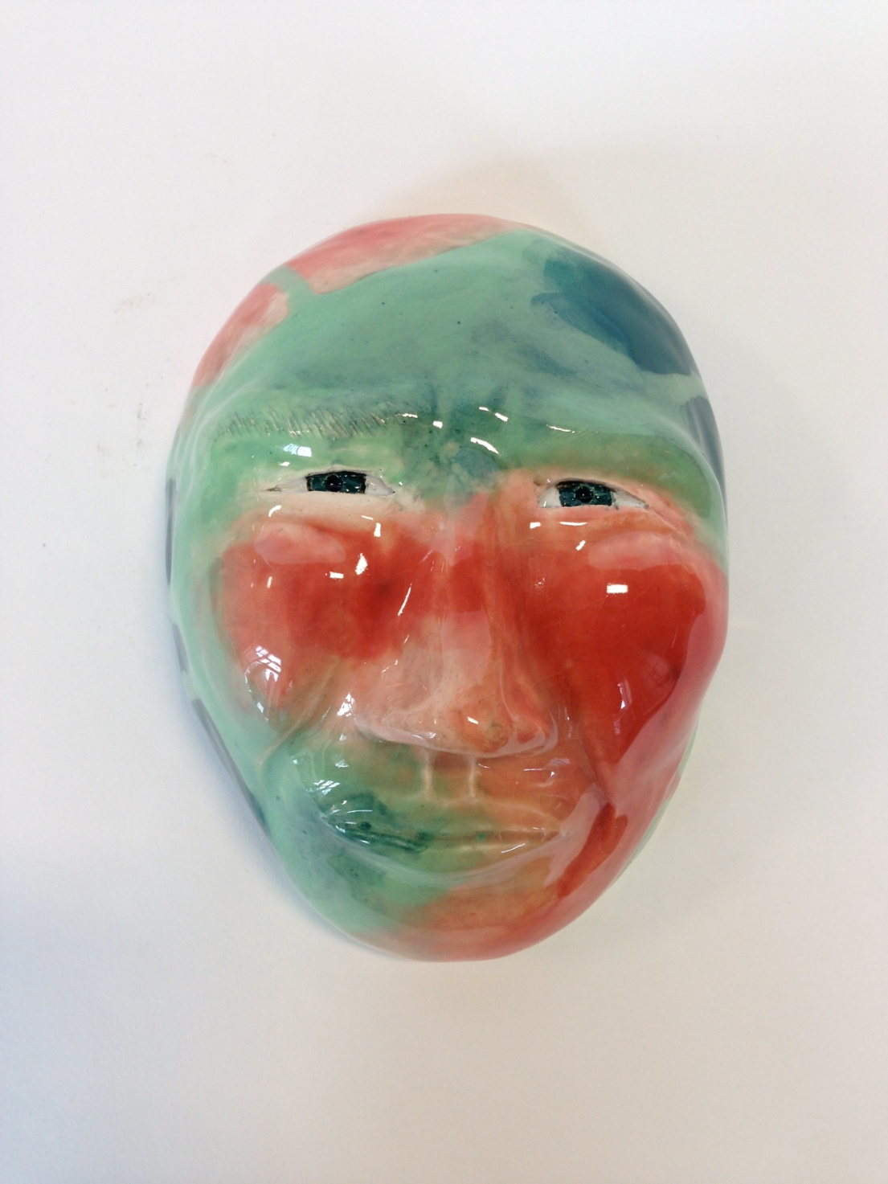
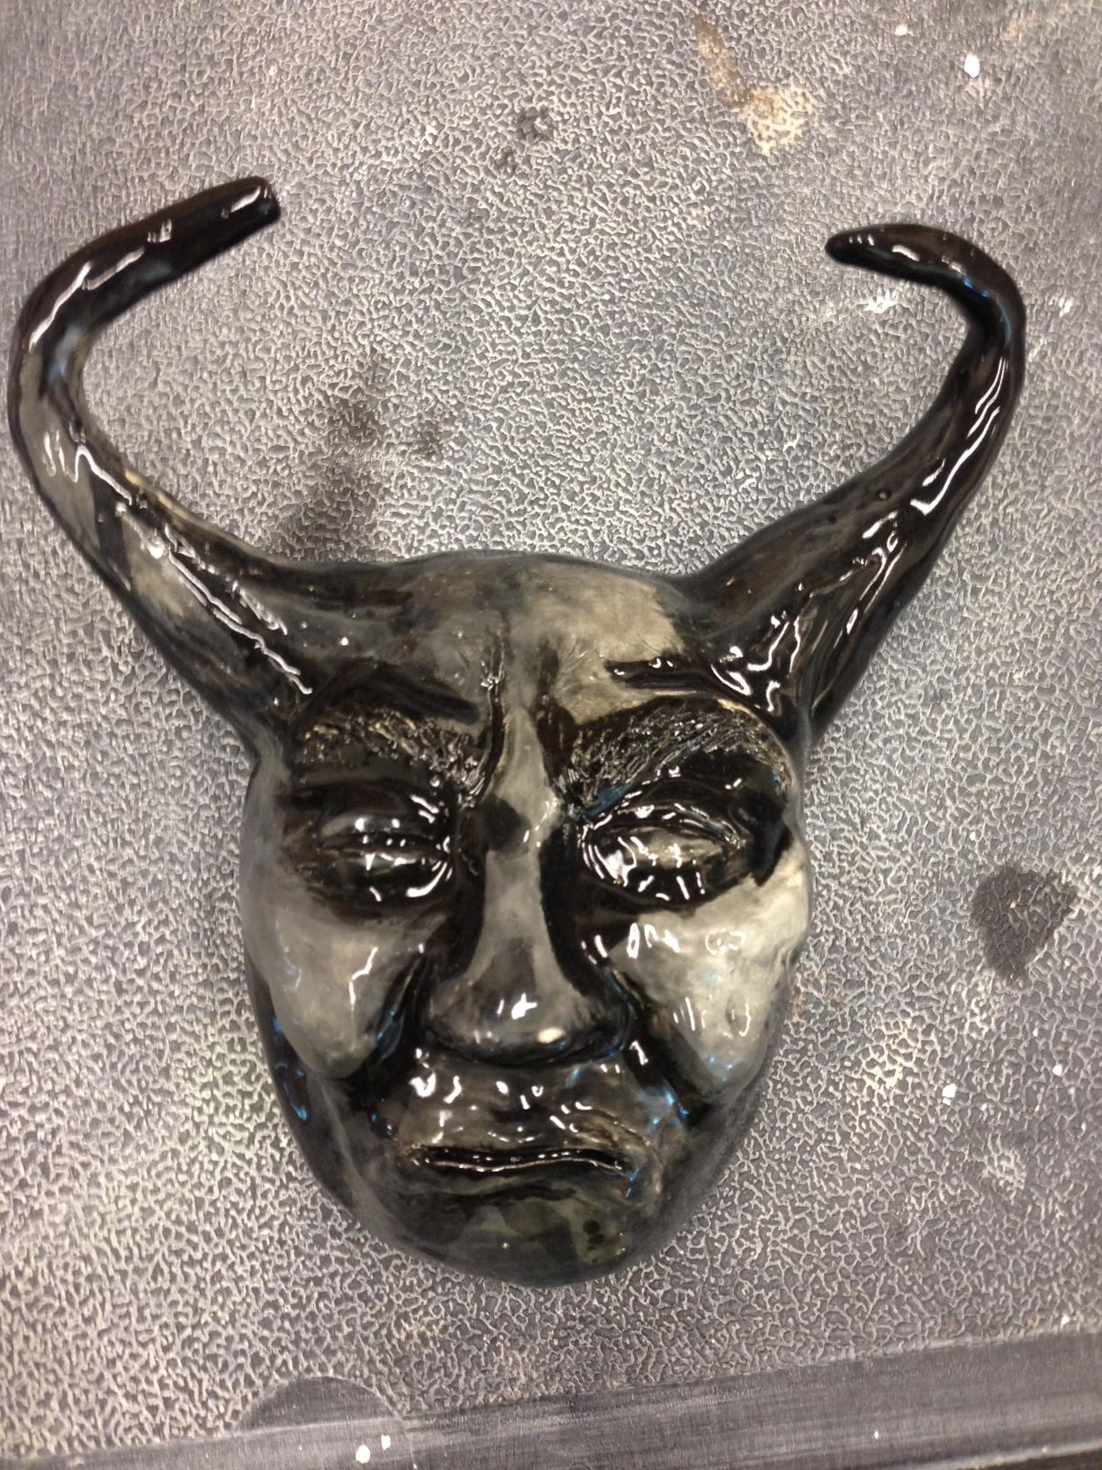

Slide 19
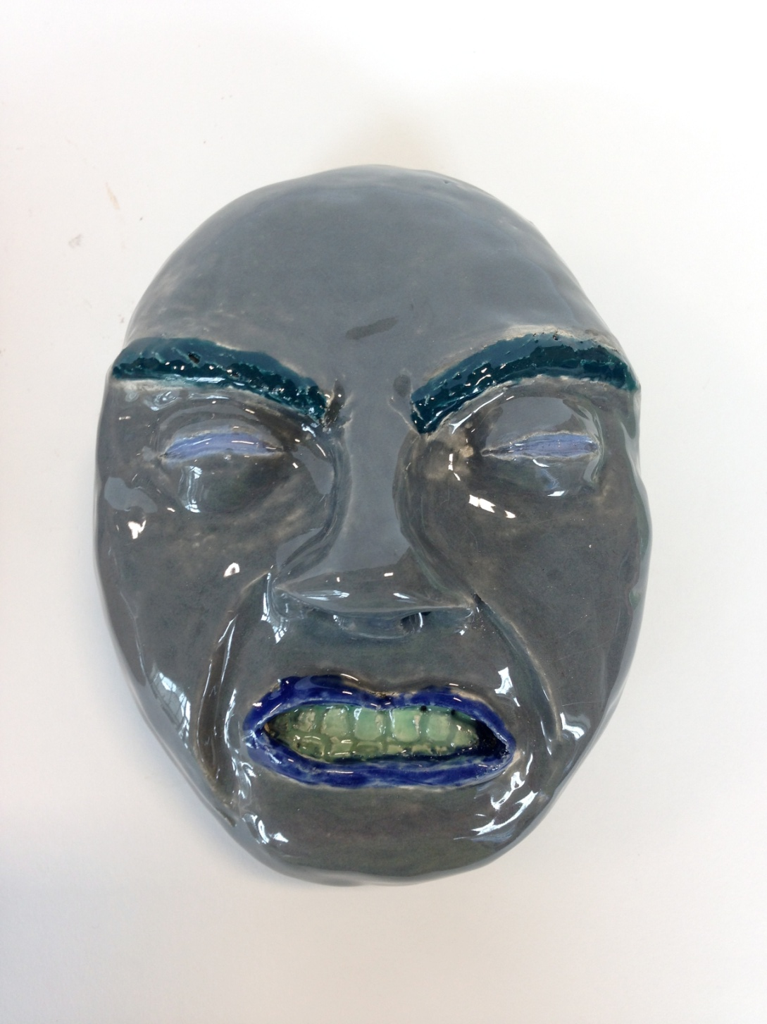
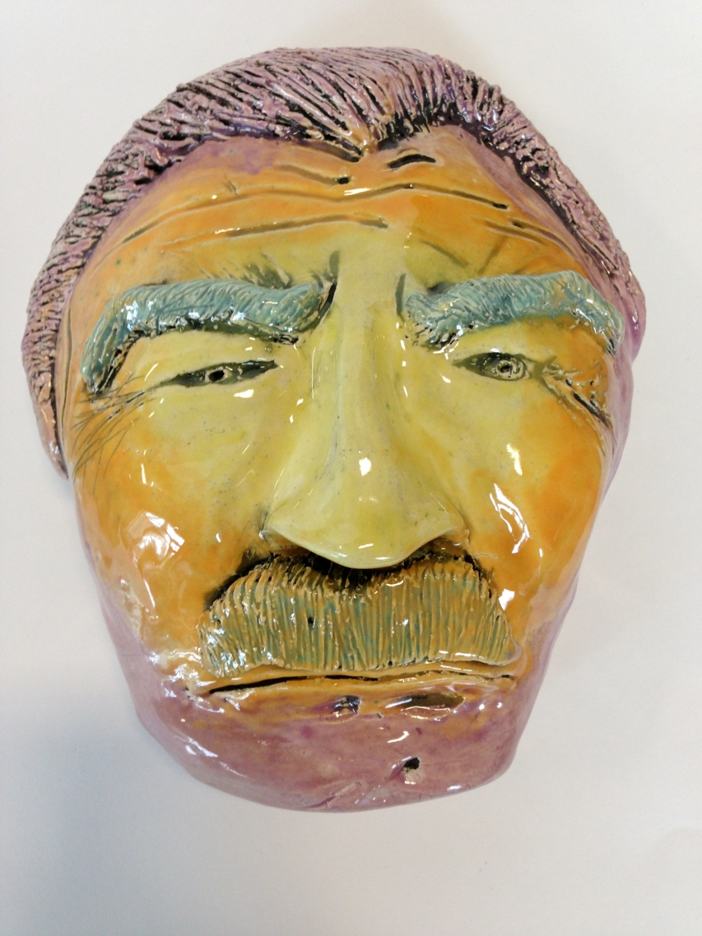

Slide 20
Your Objective
-You will create a realistic face with a unique expression
-You need to include:
All appropriate facial features
Details
Texture

