Slide 1
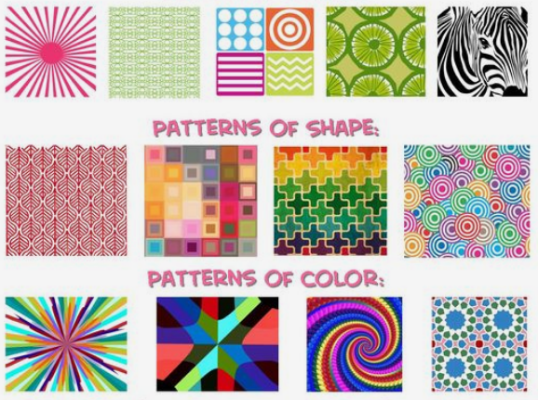

Slide 2
What makes or defines a PATTERN?

Slide 3
Jam Board

Slide 4
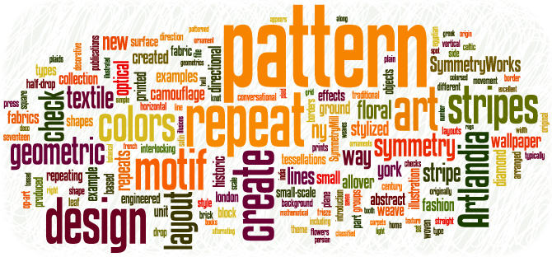
Pattern: the repetition of elements of art or anything else

Slide 5
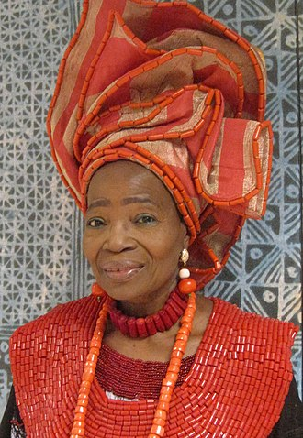
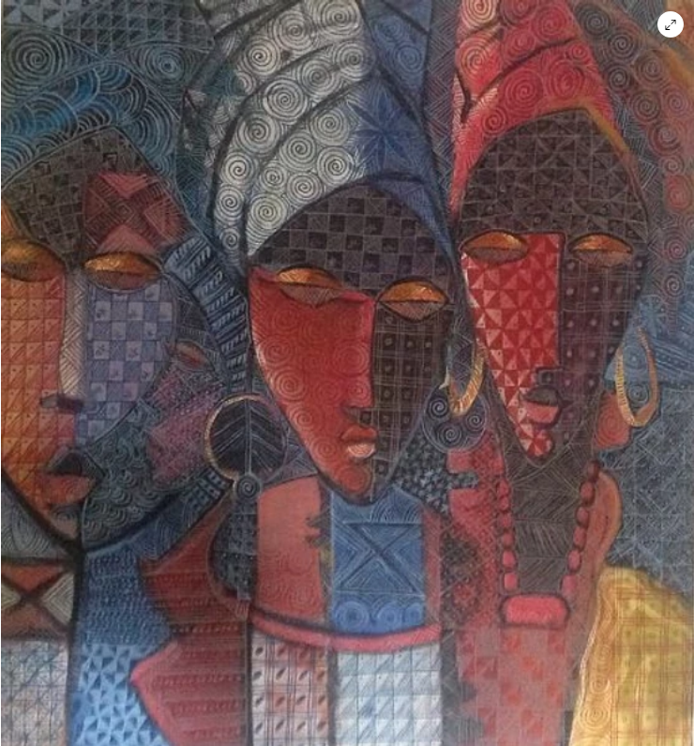
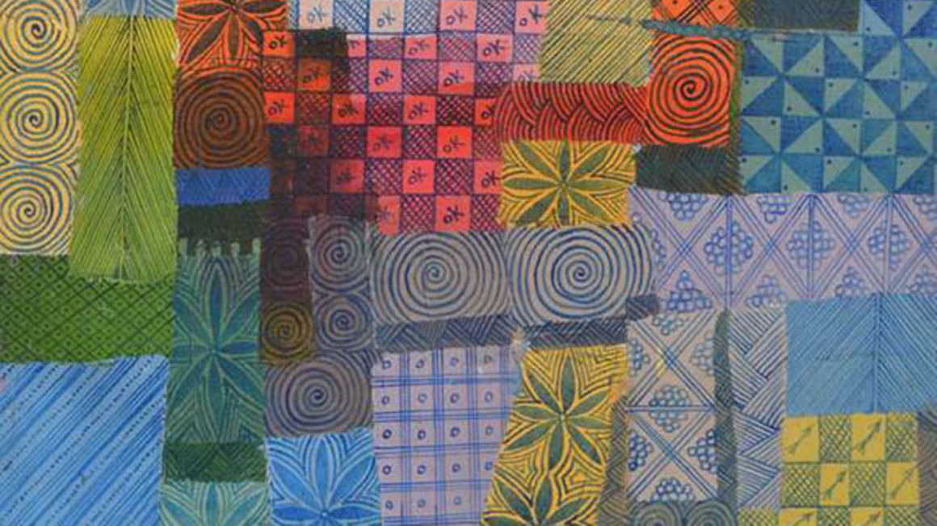
Nike Davies Okundaye (1951 - Present)
Life is Beautiful
Family of Hope, 2003

Slide 6
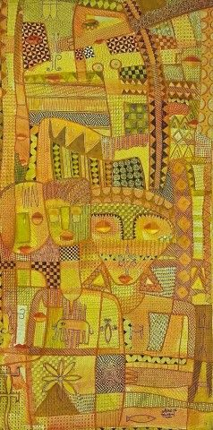
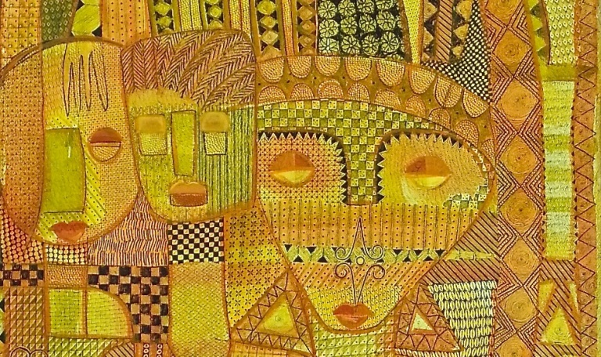
Feminine Power, 2002

Slide 7
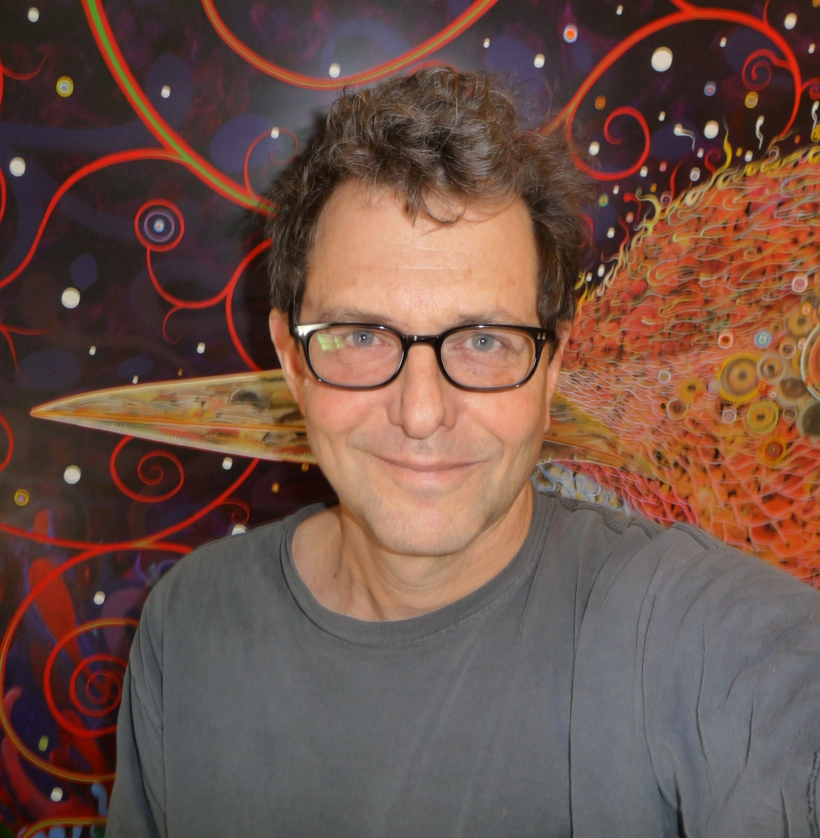
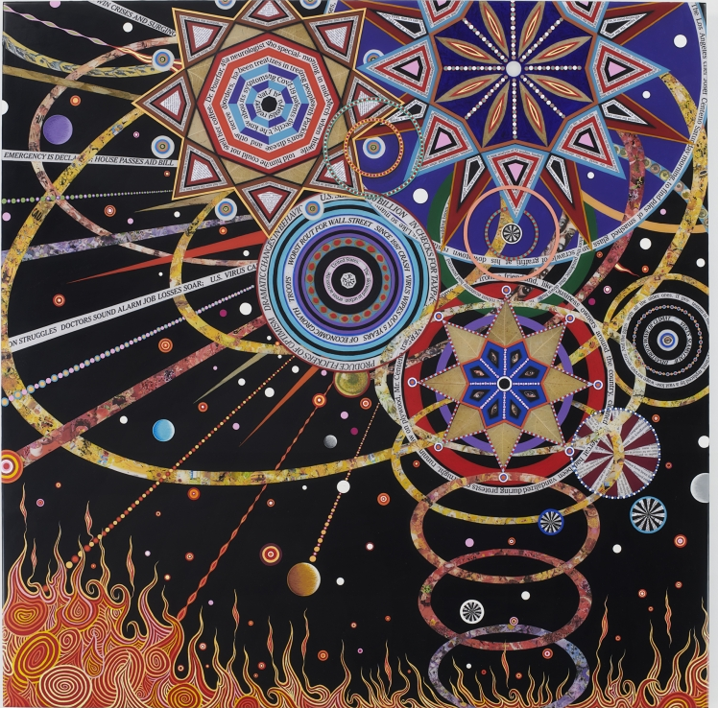
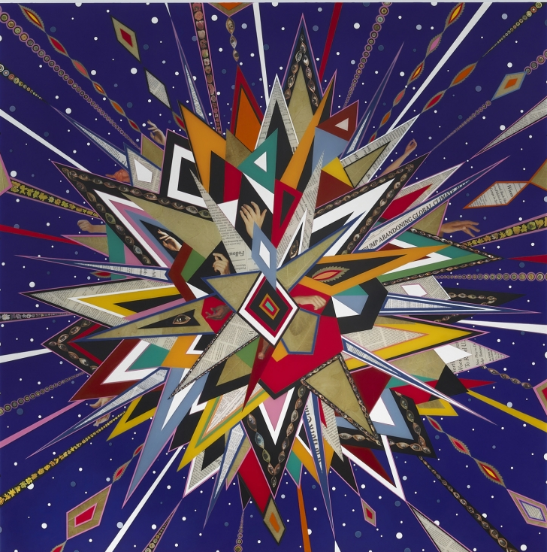
Fred Tomaselli
(1956 - Present)
Untitled, 2020
After June, 2018

Slide 8
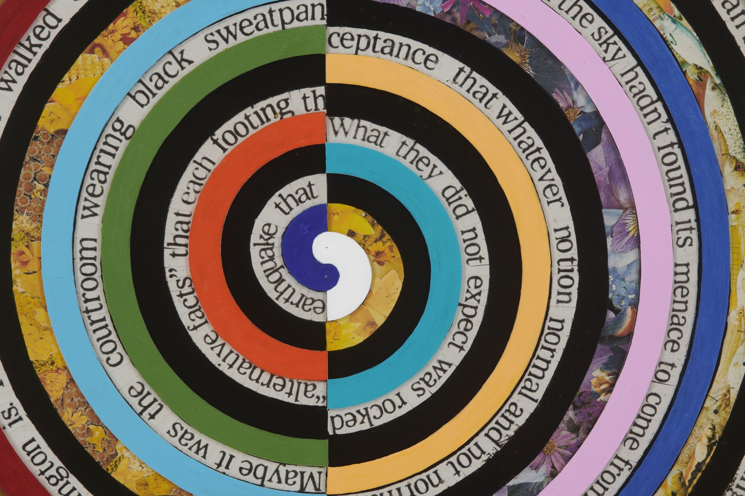
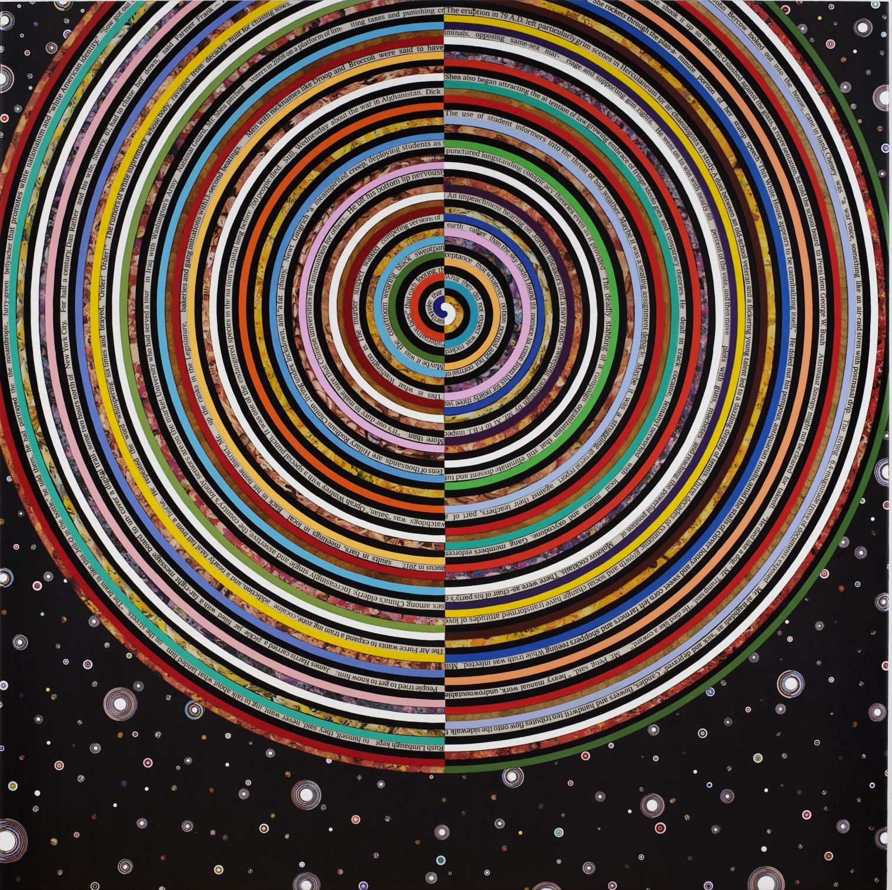
Untitled, 2020

Slide 9
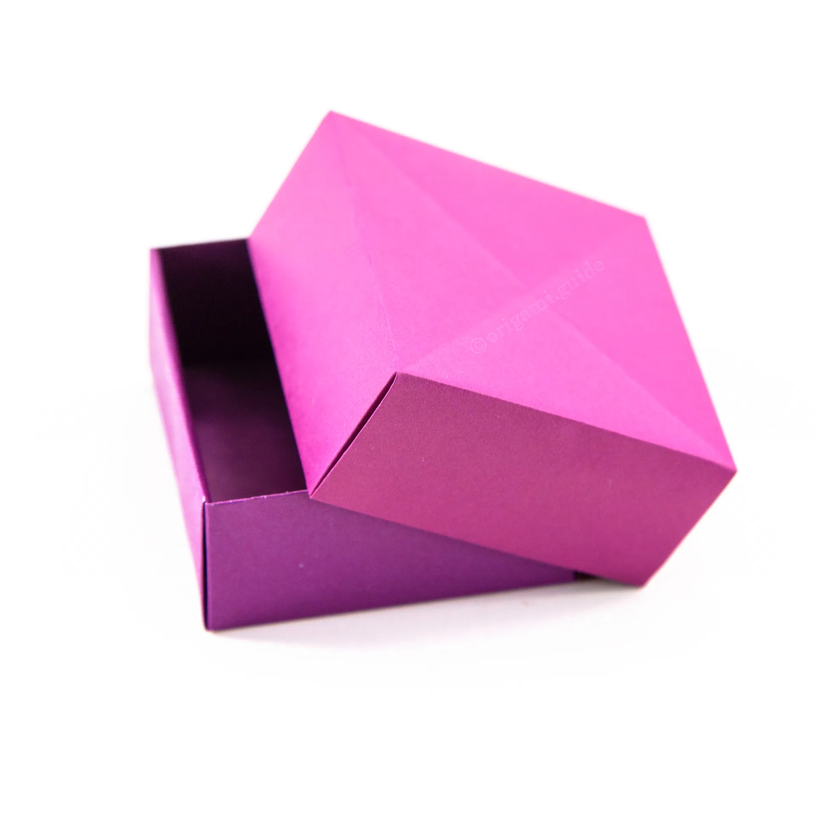
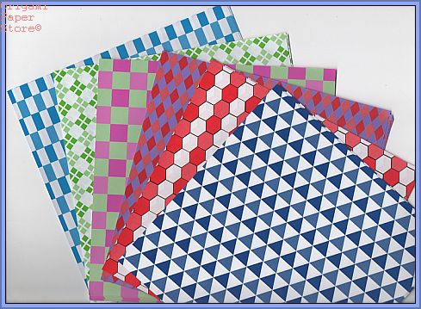
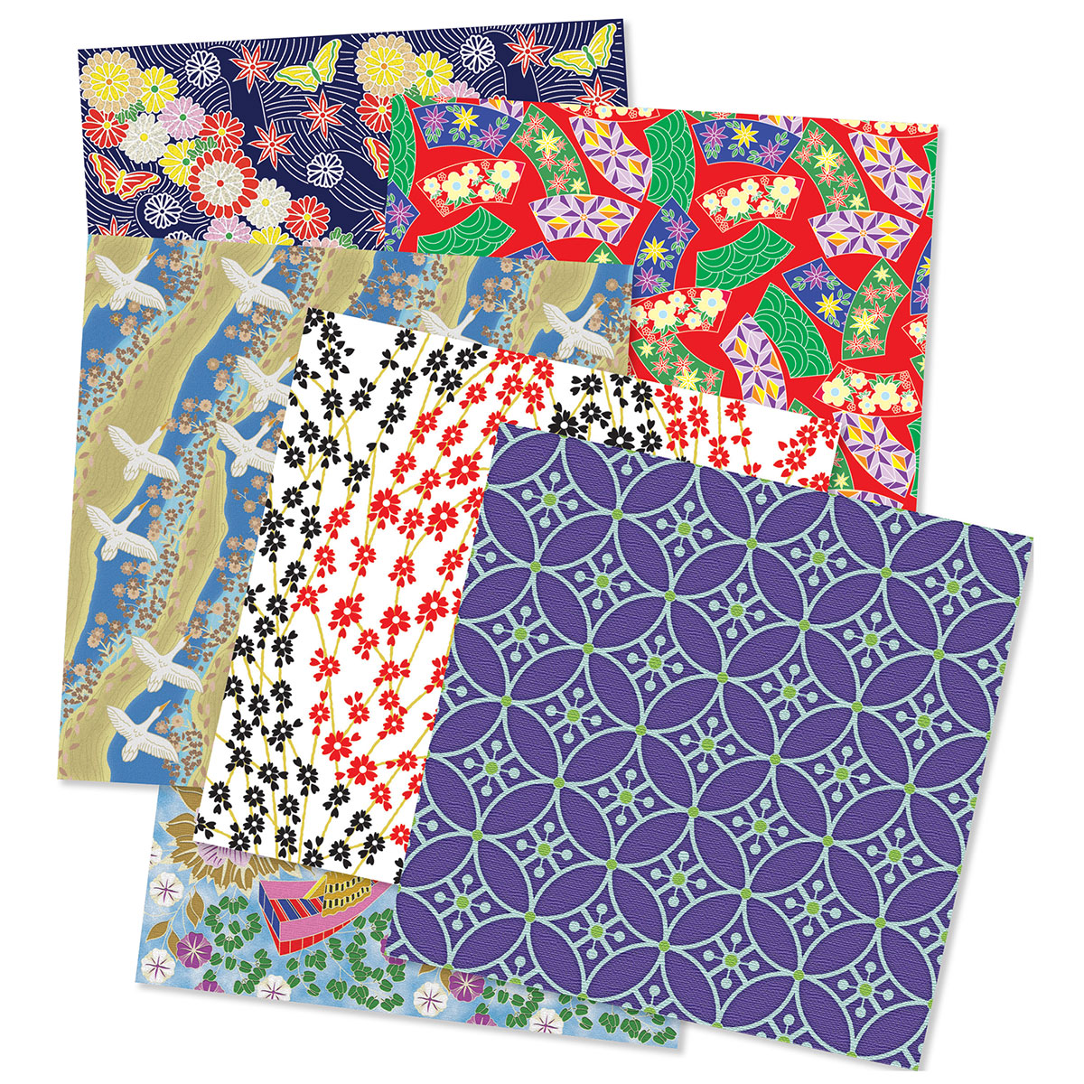
Assignment
We are going to create our own patterned paper to make an origami box

Slide 10
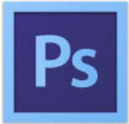


We are going to design our patterns digitally using an application that works very similarly to Adobe Photoshop or Adobe Illustrator
- These are the industry standard applications used in the commercial design field
The Pen Tool - draws straight lines and curves that are precise and accurate.
ANCHOR POINTS:
anywhere you click to change the direction of the line
Handlebars:
turn straight lines into curves
In order to get the handlebars you need to
“click and drag”
in the direction the line is going

Slide 11
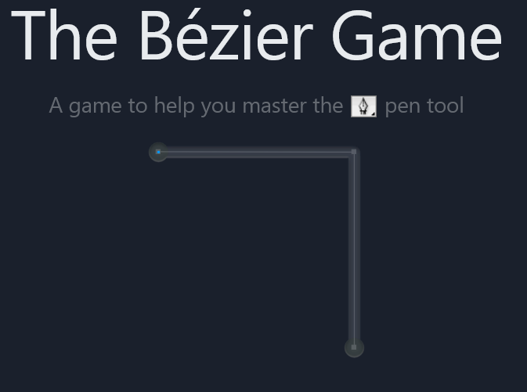
We are going to practice using the pen tool by playing this game!
The Bezier Game

Slide 12
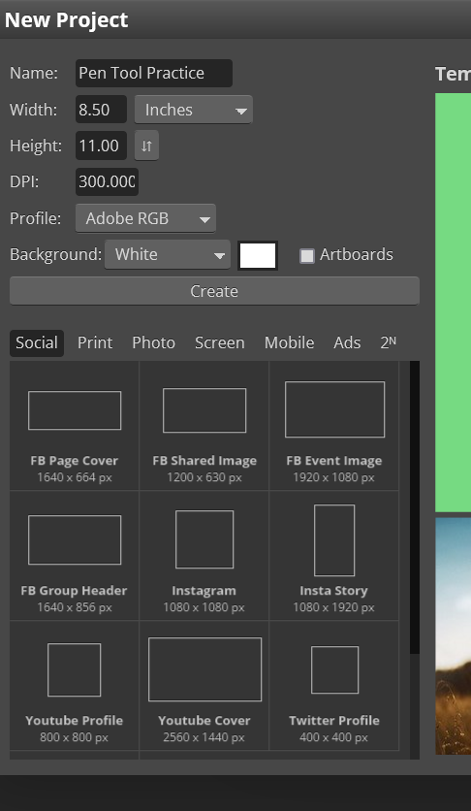
Go to - Photopea.com
Select “New Project”
Change the name
Change the units of measure to inches
Change the width to 8.5
Change the height to 11
Change the DPI (dots per inch) to 300
  300 DPI is the industry standard for printing
Click Create
1
3
2
4
5
6

Slide 13
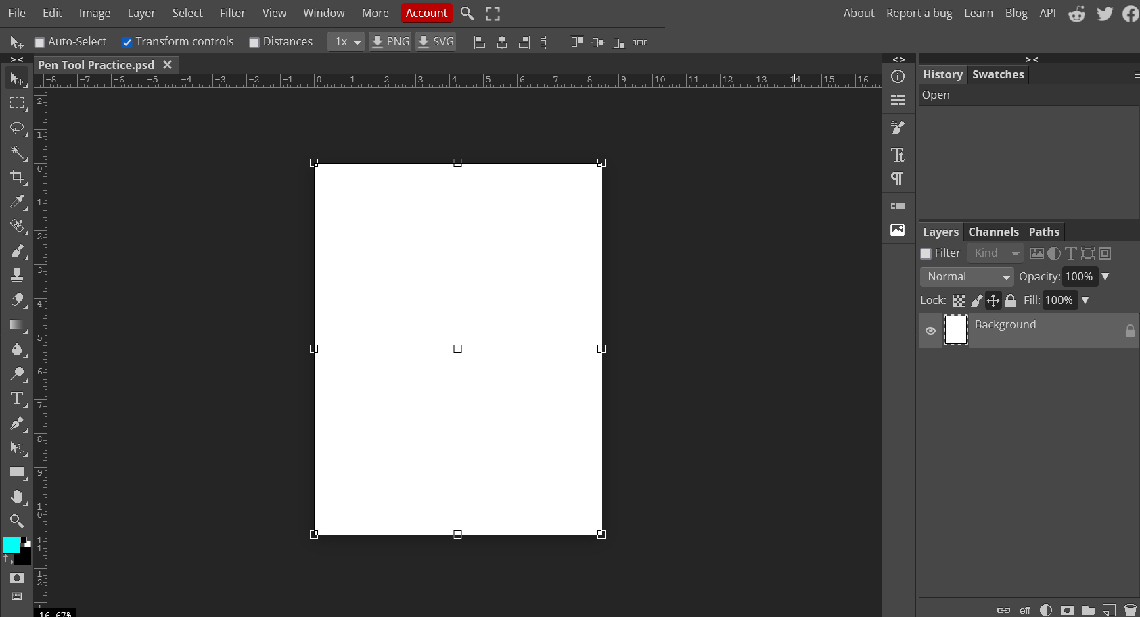
OPTIONS MENU
ART BOARD
TOOL BAR
LAYERS PANEL

Slide 14
In the LAYERS PANEL
The layer on top is the layer that can be seen -
just like a stack of papers
New Folder - folders “group” layers together
New Layer
Delete Layer - Garbage

Slide 15
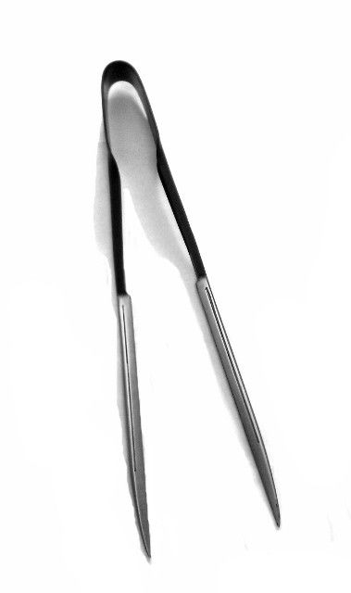
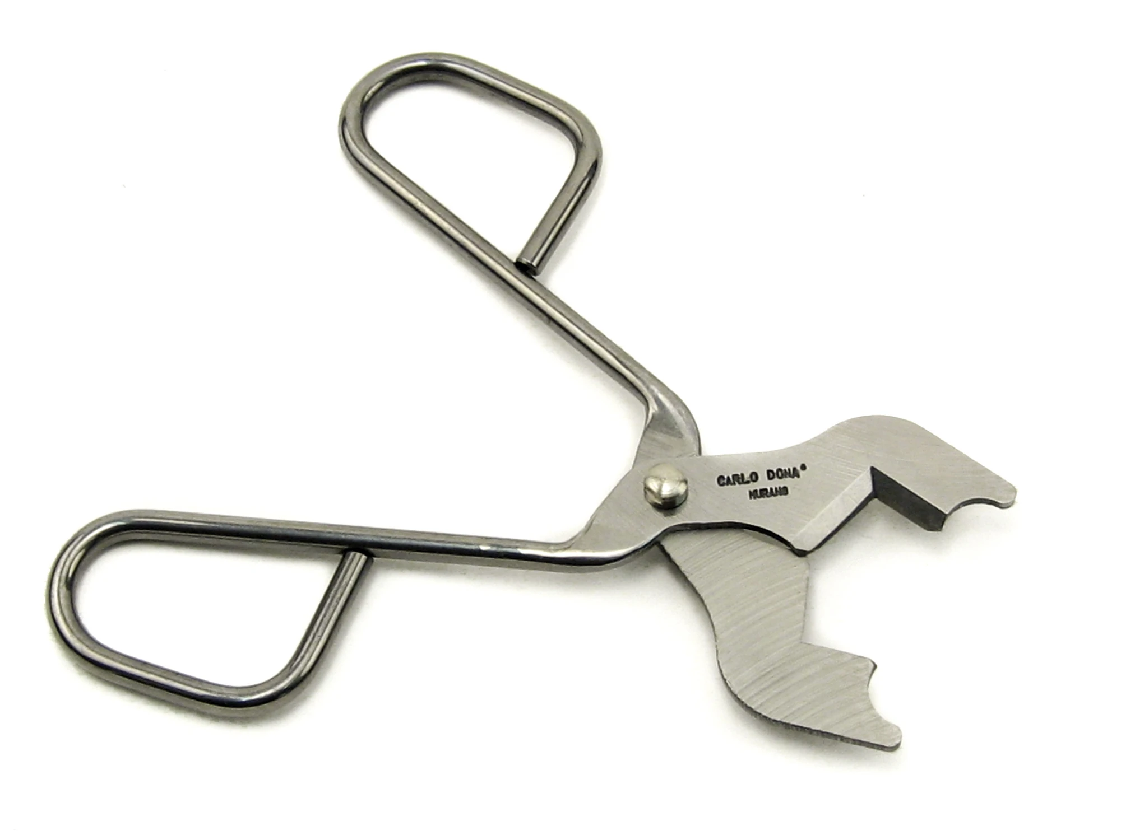
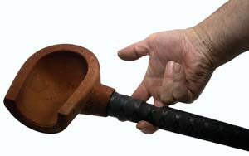
Find an image you want to “TRACE”
I chose tools used for glass blowing

Slide 16
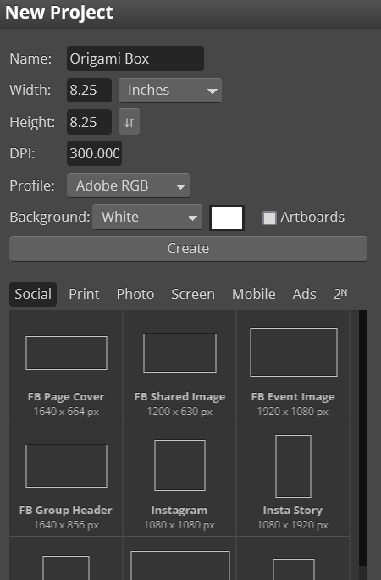
Go to - Photopea.com
Settings for the origami box
Select “New Project”
Change the name
Change the units of measure to inches
Change the width to 8.25
Change the height to 8.25
Change the DPI (dots per inch) to 300
  300 DPI is the industry standard for printing
Click Create
1
3
2
4
5
6

Slide 17
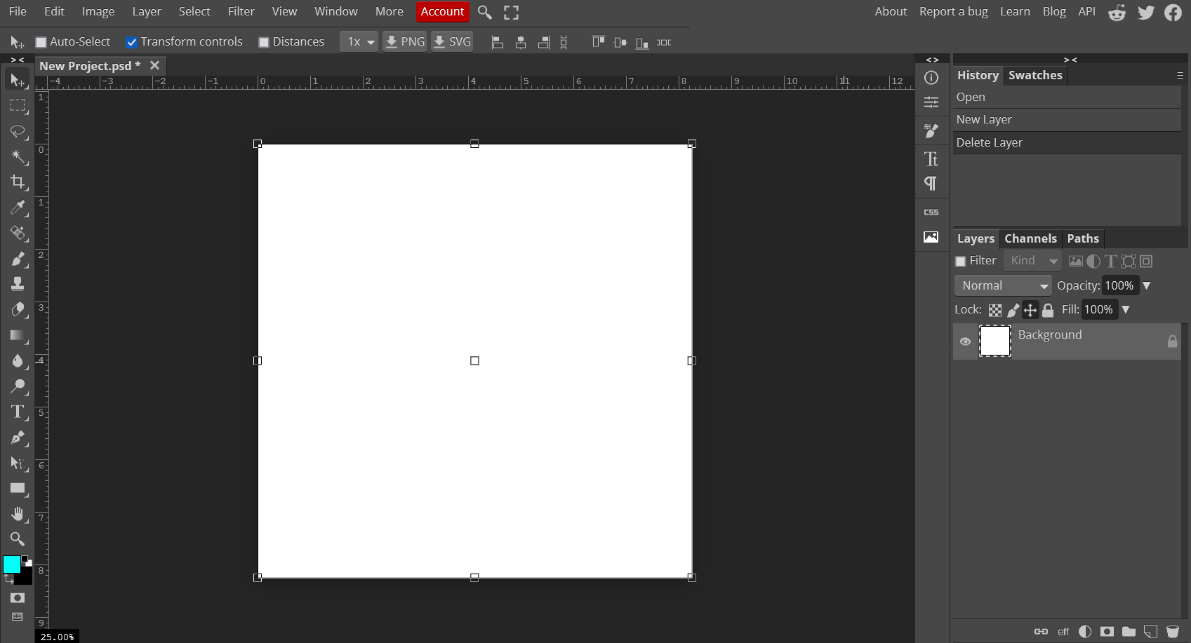

Slide 18
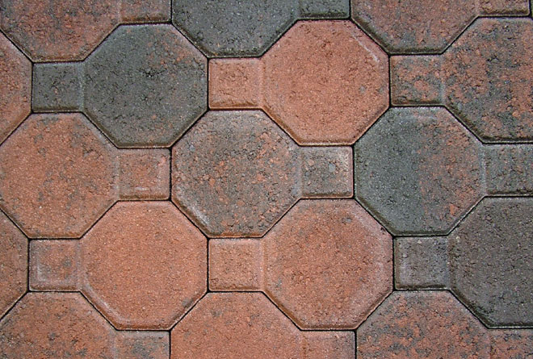
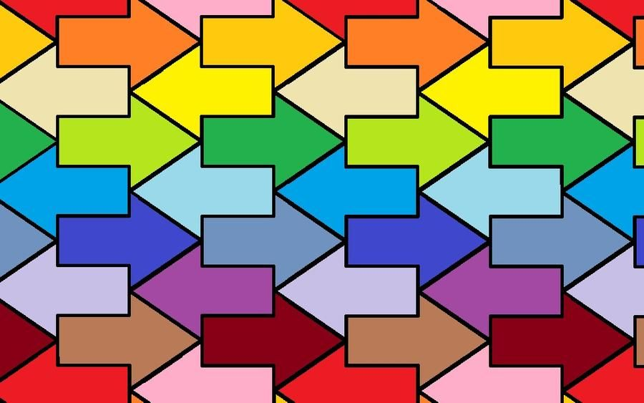
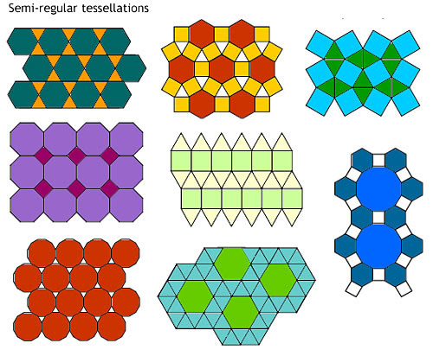
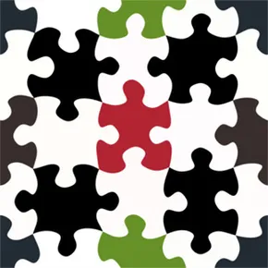
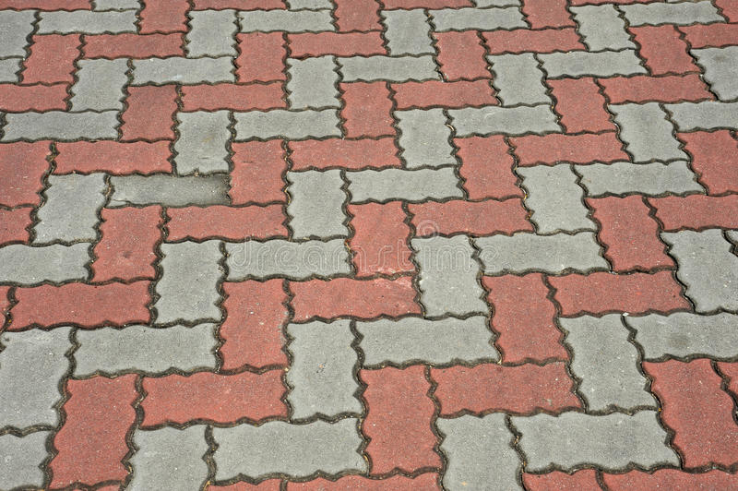
TESSELLATION
A pattern made by repeating shapes with no gaps or overlaps

Slide 19
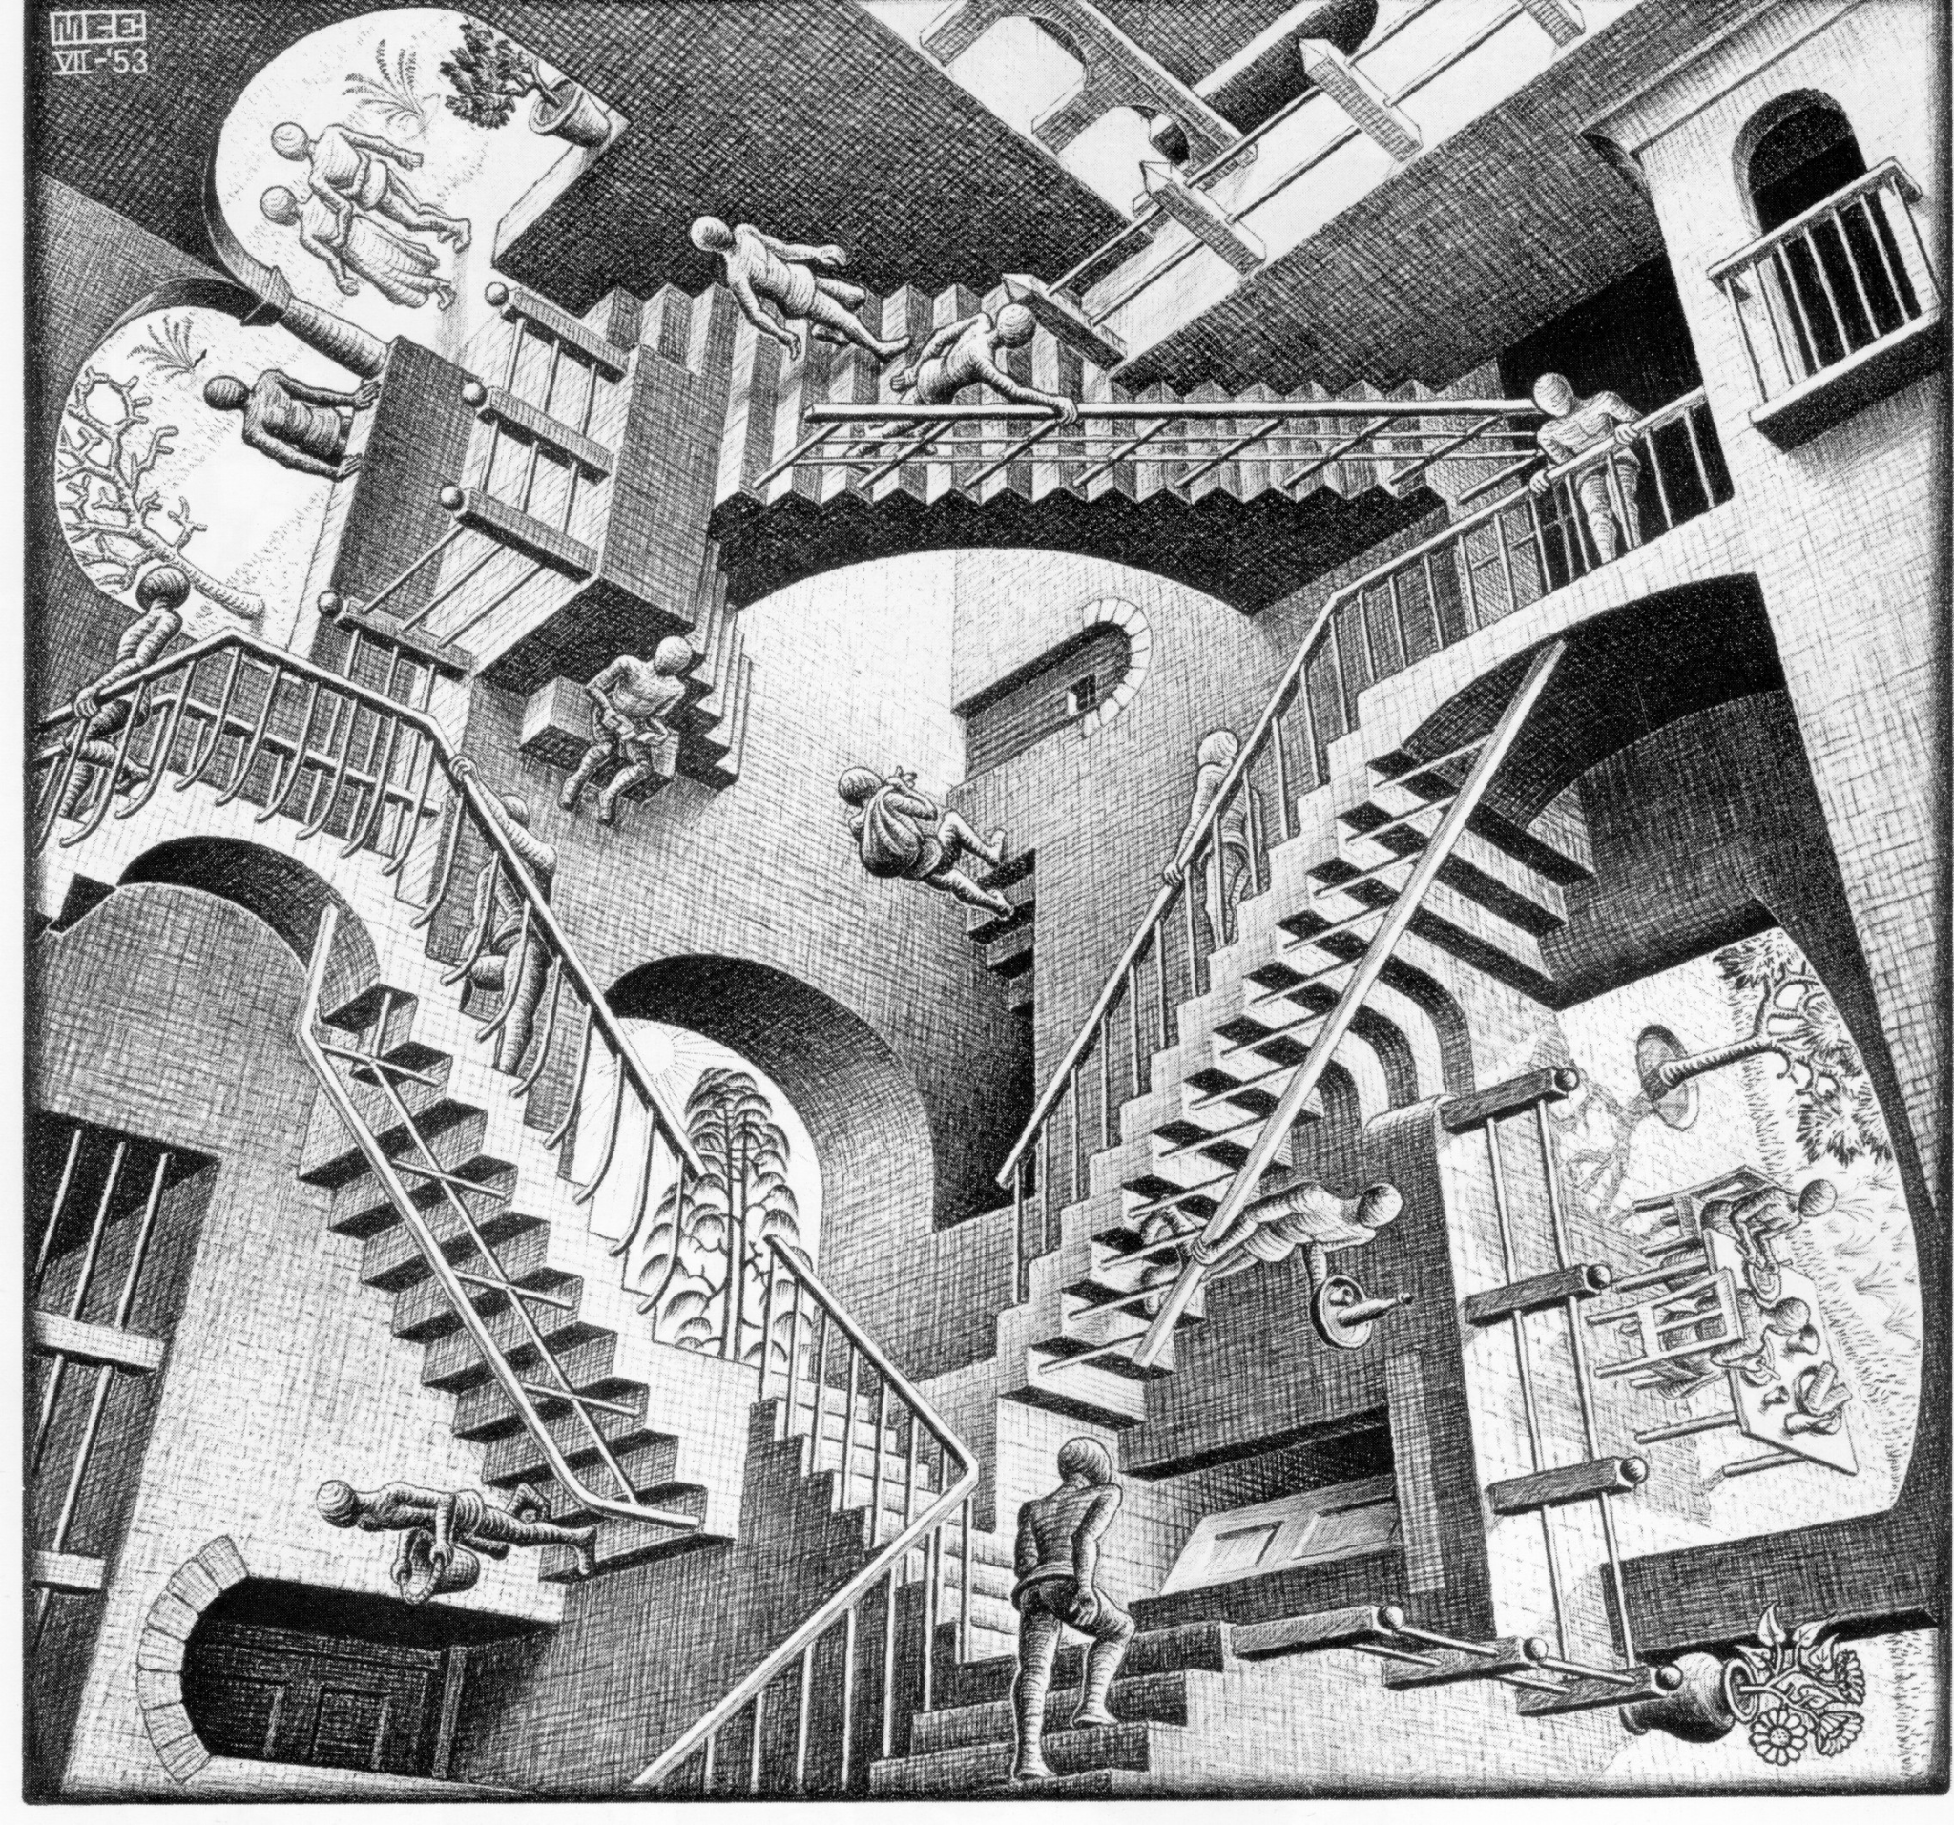
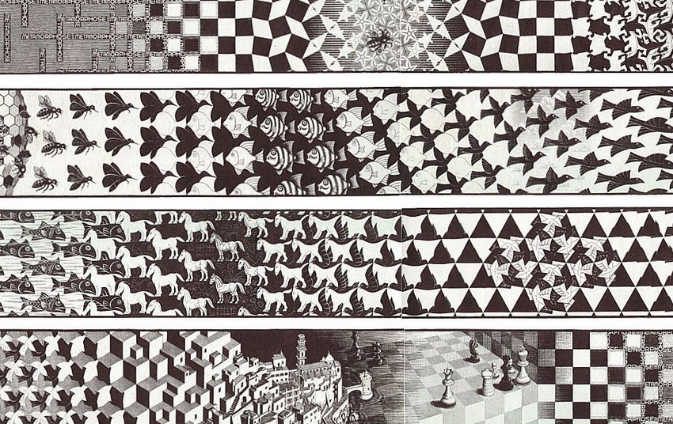
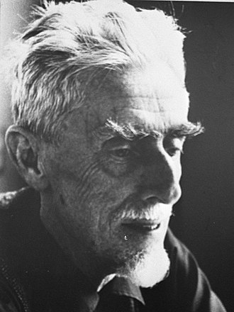
Relativity, 1953
M.C. Escher
(1898 - 1972)
Metamorphosis, 1968

Slide 20
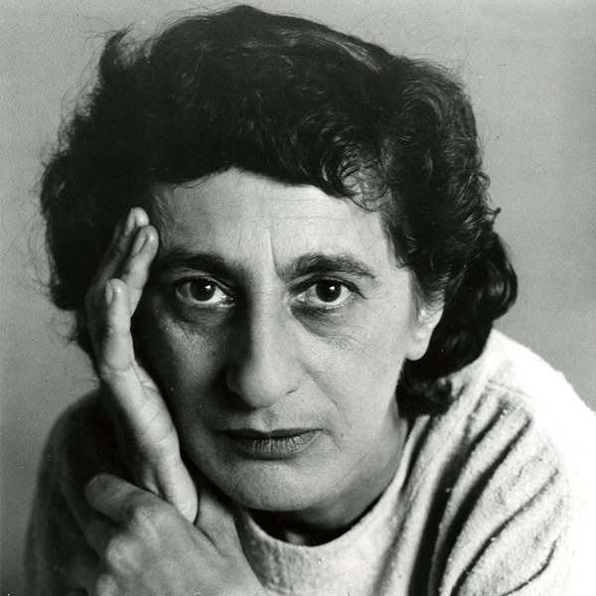
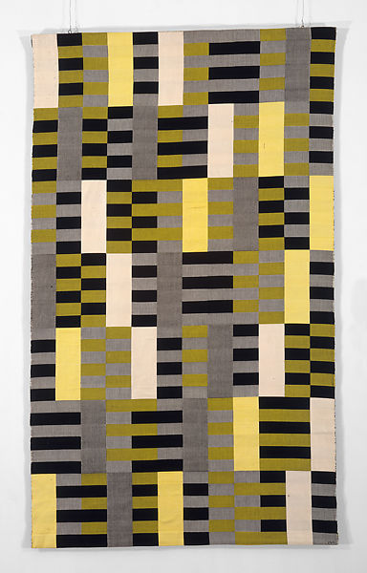
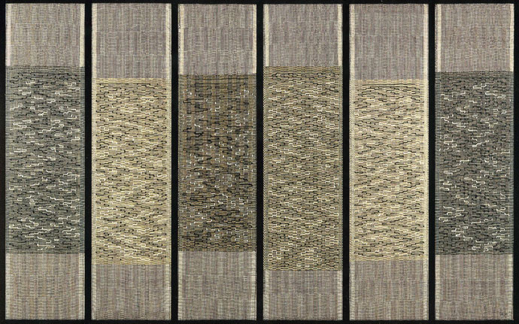
Anni Albers (1899-1994)
Six Prayers, 1965
Black-White-Yellow, 1926

Slide 21
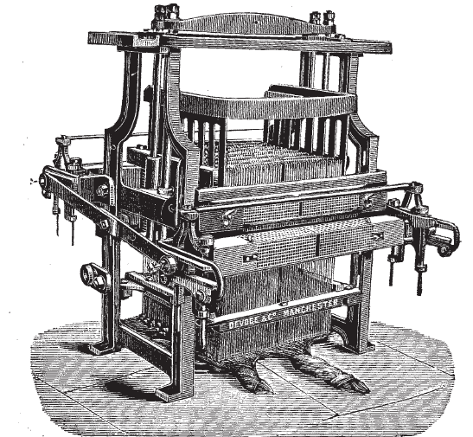
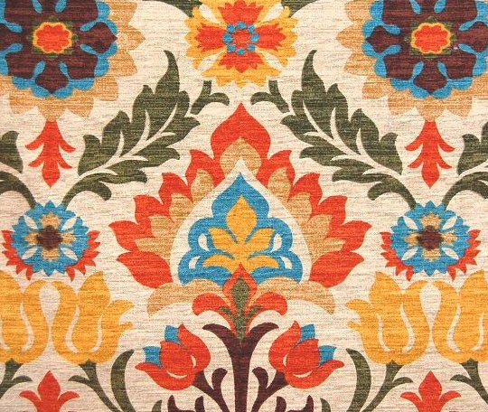

Did you know...
Lead to
Leads to

Slide 22
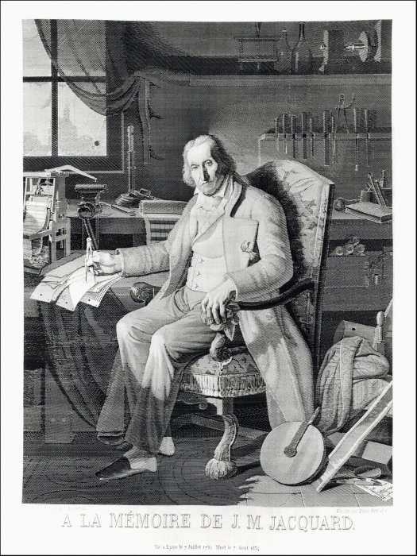
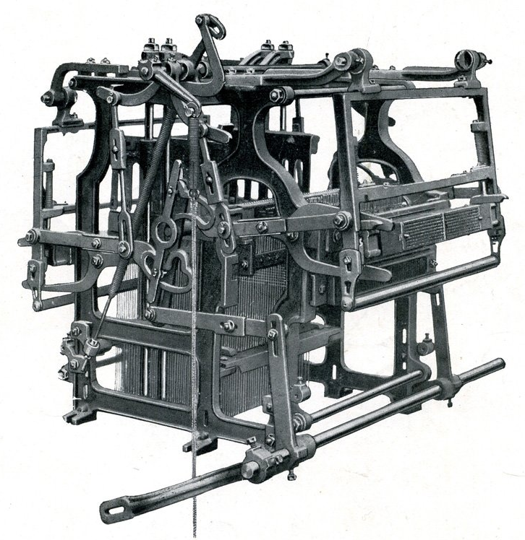
How 18th Century ideas connect to 21st Century technology
Read:
The Story of the Jacquard Loom - The Science & Industry Museum in Manchester,
The Jacquard Machine - Wikipedia
Watch:
Connections 1978 TV series about how inventions throughout history are connected (about 5 minutes)
Henry Ford Museum short video (about 2 minutes)
How Was It Made a good video to see machine in action. There is no sound, text to explain (about 4 minutes)
How Does Binary Code Work
This portrait is a tapestry made by the Jacquard Loom

Slide 23
Additional Resources
Glossary of Patterns many different examples of patterns and pattern strategies
Zentangle Doodles watch this video for ways you can practice hand drawing easy and effective patterns.
Zentangle Instructions step by step instructions for making zentangle doodles.

