Slide 1
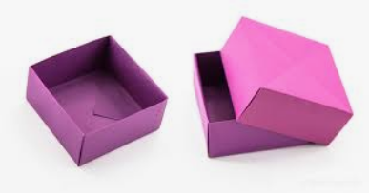
How to fold a masu
origami box

Slide 2
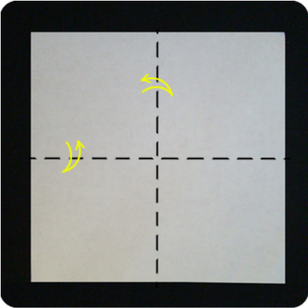
Step 1
Start with a square piece of paper, printed side down
Fold in half left and right sides then open
Fold in half top and bottom then open

Slide 3
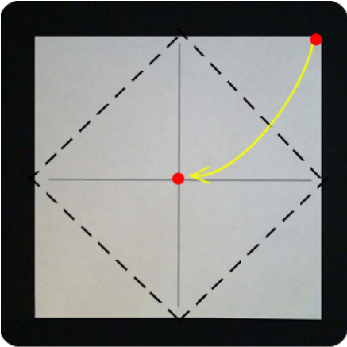
Step 2
Fold the corner to the center
  Connect the red dots
Do this for all 4 corners

Slide 4
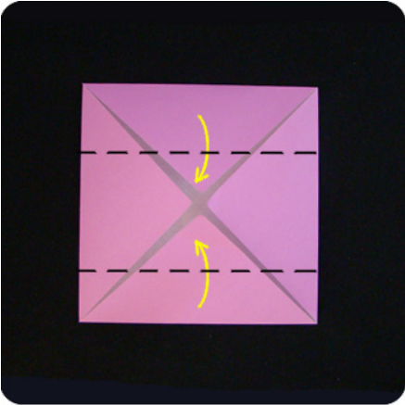
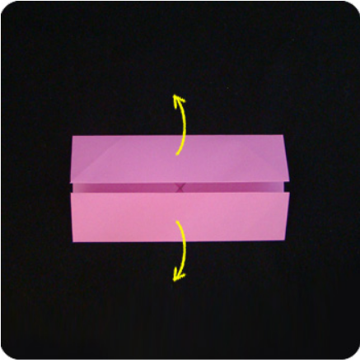
Step 3
Fold the top edge to the horizontal midline
Fold the bottom edge to the horizontal midline
Then open (unfold)

Slide 5
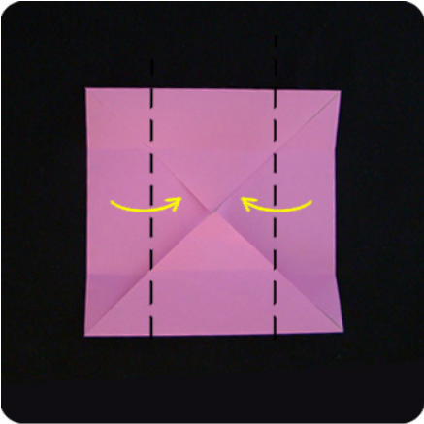
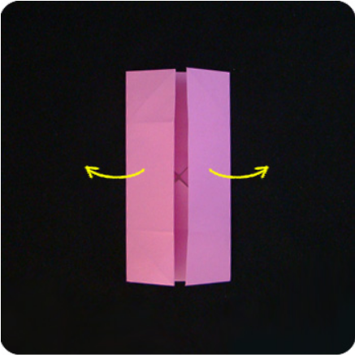
Step 4
Fold the left edge to the vertical midline
Fold the right edge to the vertical midline
Then open (unfold)

Slide 6
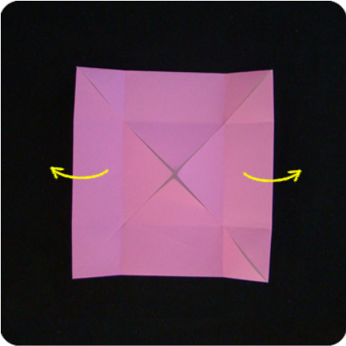
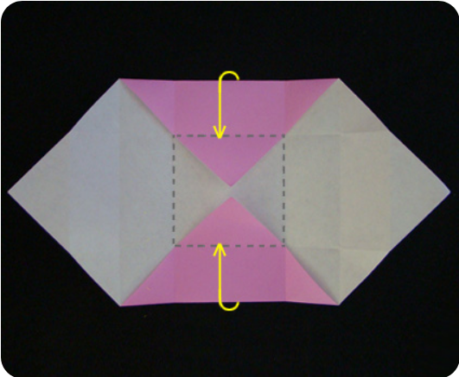
Step 5
Unfold the left and right triangles
Step 6
Fold the top and bottom edges up along creases so the they are perpendicular to the flat paper
*The dashed line square is the base (or top) of the box

Slide 7
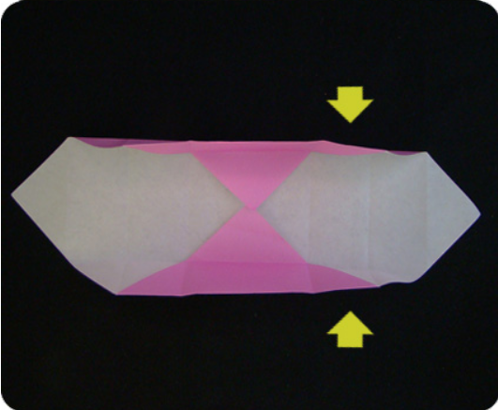
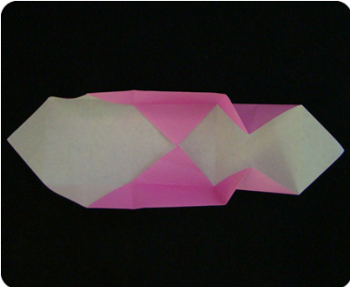
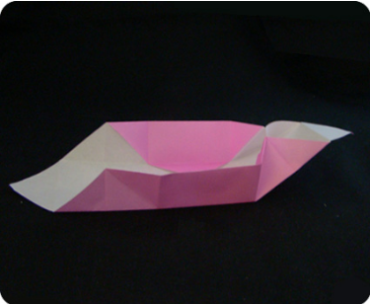
Top View
Step 7
This is the tricky part
Form the corners of the box by pushing in on the creases at the end of the triangles to reverse them.
Side View

Slide 8
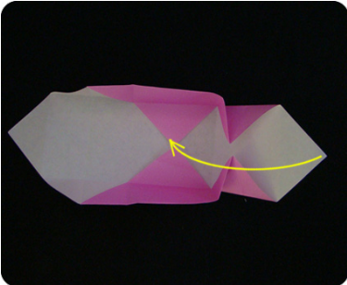

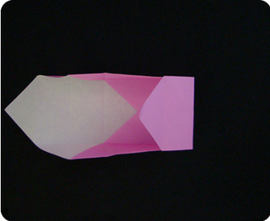
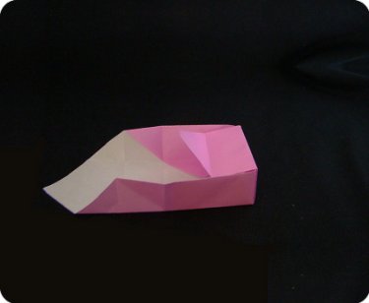
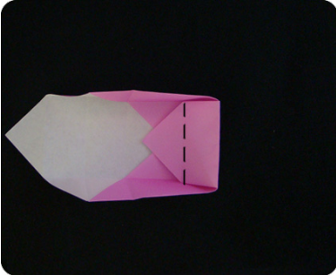
Top View
Step 8
Side View
Lift the triangle flap towards the center of the box
Fold the triangular flap over the edge of the box.
Fold and tuck the remaining paper into the base of the box.

Slide 9
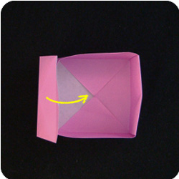
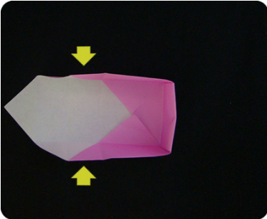
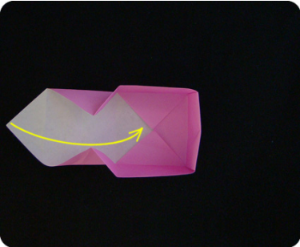
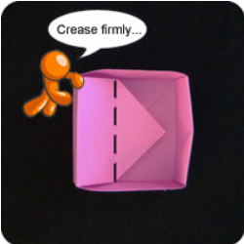
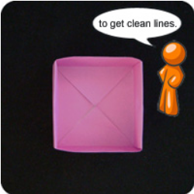
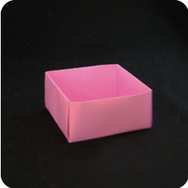
Step 9
Repeat on the other side of the box
Done

